Slide 1
Final Project Presentation
Group 18
Chen Yihui, Shen Yixiu, Wang Longfei, Wang Renjie
Github repo link : https://github.com/Wang-Theo/ME5413_Final_Project

Slide 2
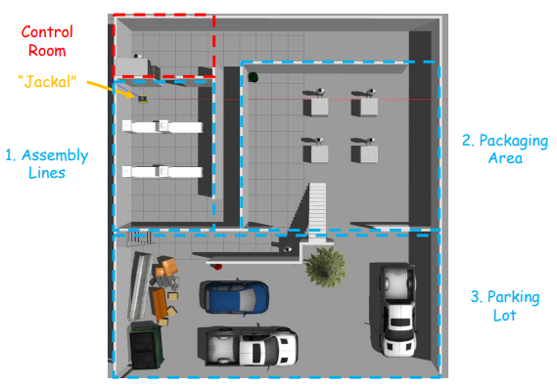
Description
A mini-factory environment in Gazebo.
3 accessible areas
1 inaccessible area.
The aim of the project is to design a robot navigation software stack that :
From the starting point, move to the given pose within each area in sequence:
Assembly Line 1, 2
Packaging Area 1, 2, 3, 4
Delivery Vehicle 1, 2, 3
Task 1 Mapping
Task 2 Navigation
Figure 1. Schematic of working space

Slide 3
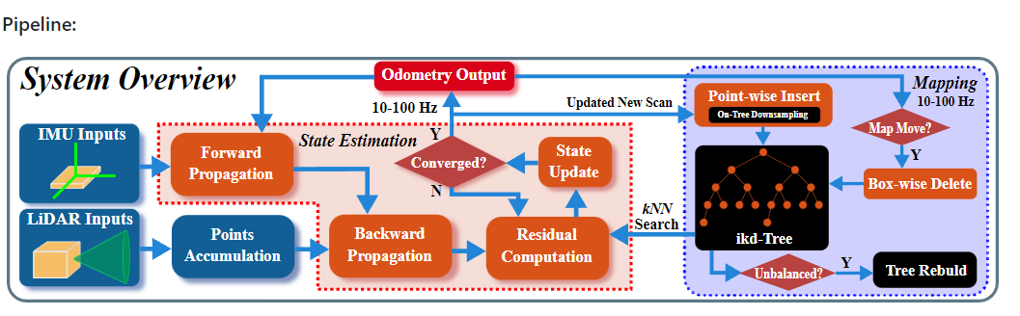
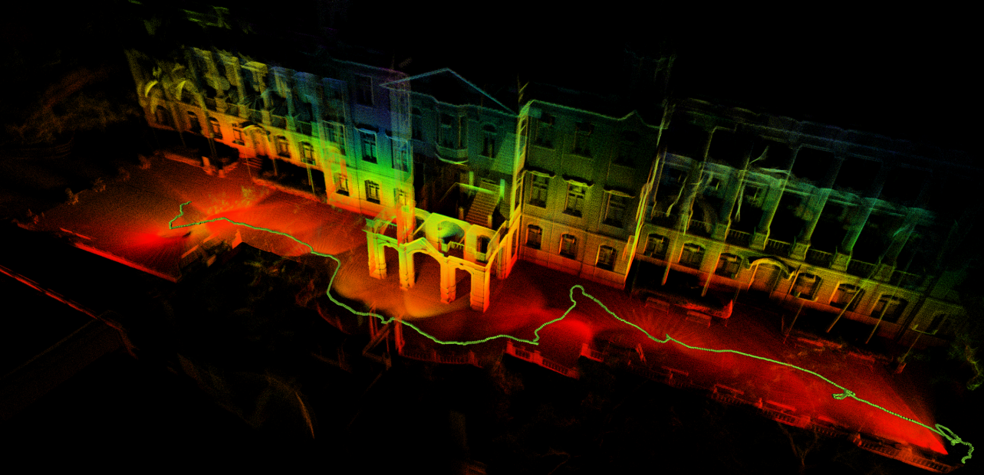
Task 1 Mapping
FAST-LIO Introduction
FAST-LIO (Fast LiDAR-Inertial Odometry) is a computationally efficient and robust LiDAR-inertial odometry package. It fuses LiDAR feature points with IMU data using a tightly-coupled iterated extended Kalman filter to allow robust navigation in fast-motion, noisy or cluttered environments where degeneration occurs. Our package address many key issues:
Fast iterated Kalman filter for odometry optimization;
Automatically initialized at most steady environments;
Parallel KD-Tree Search to decrease the computation;
Figure 2. System overview of FAST-LIO2.[1]
Figure 3. Sample mapping results [2]

Slide 4
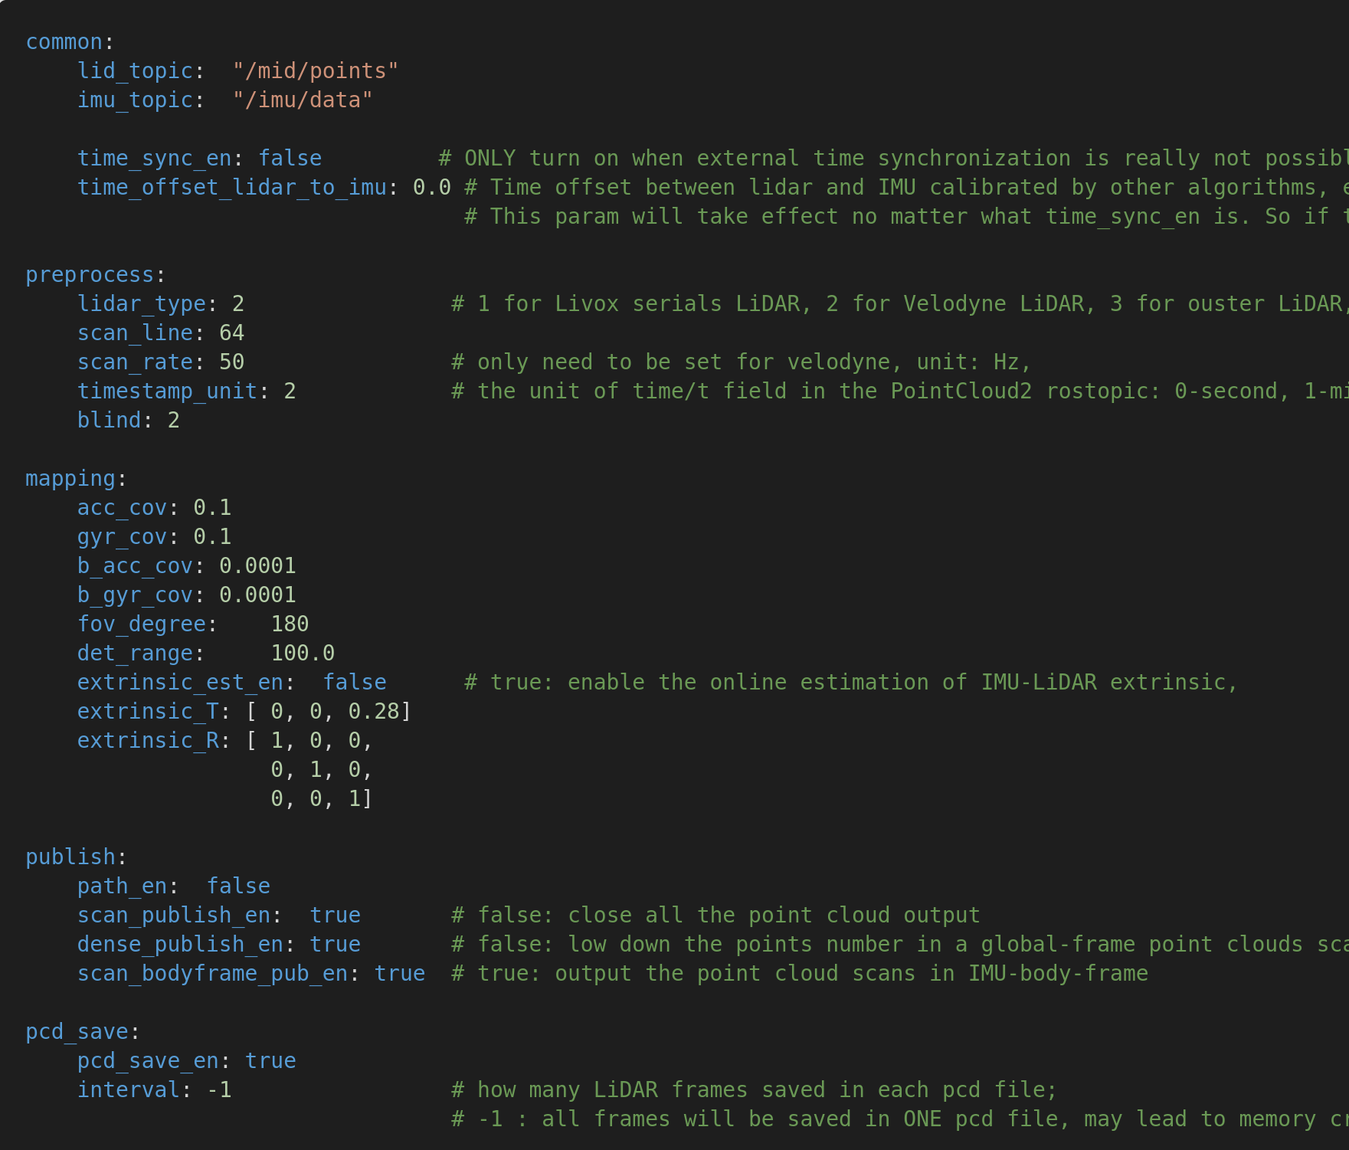
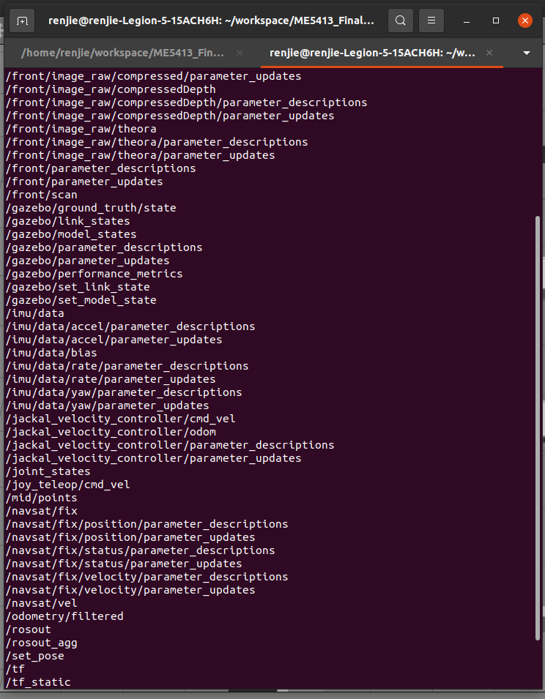
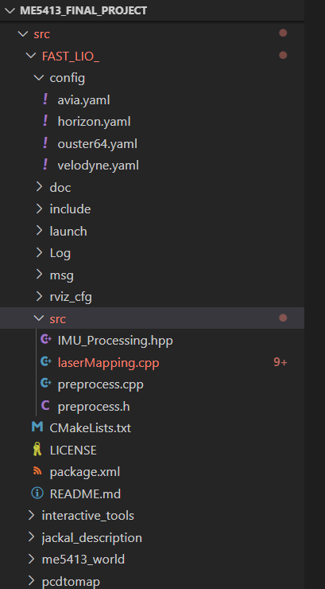
Task 1 Mapping
FAST-LIO Development
Figure 4. Screenshot of velodyne.yaml

Slide 5
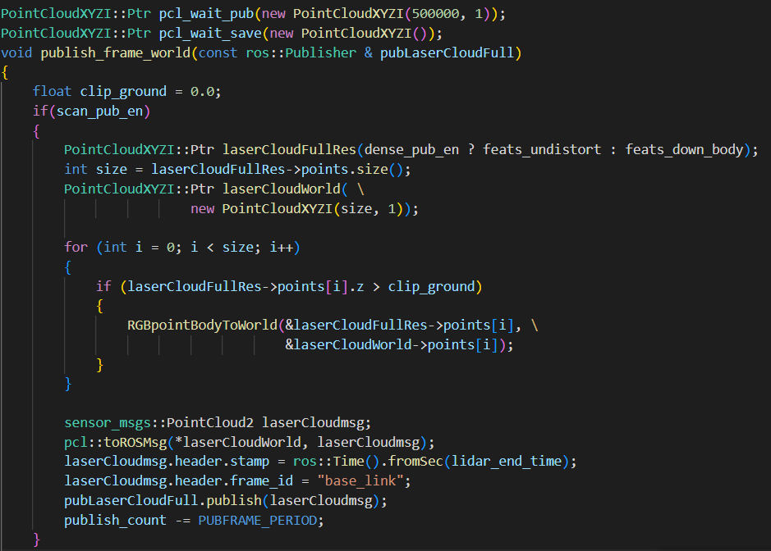
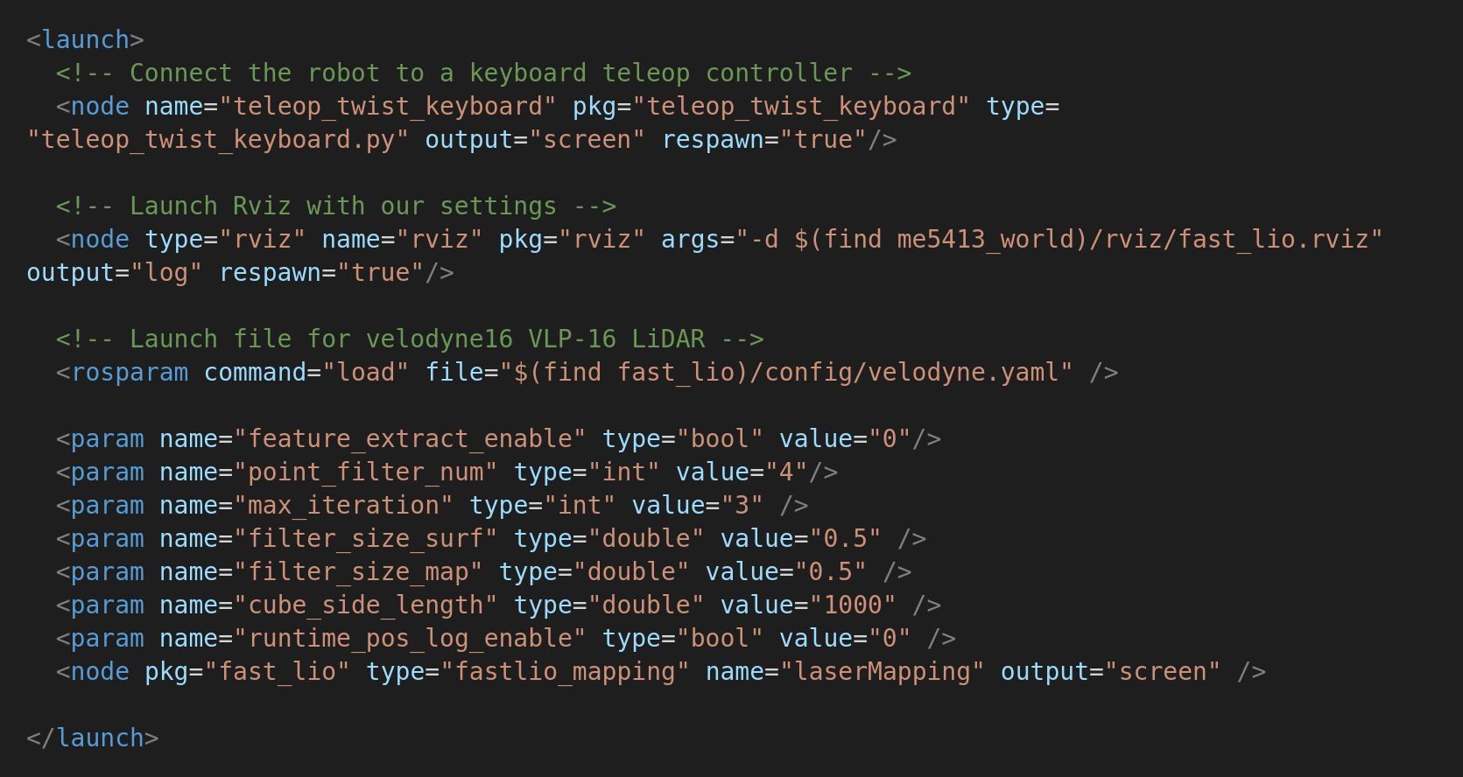
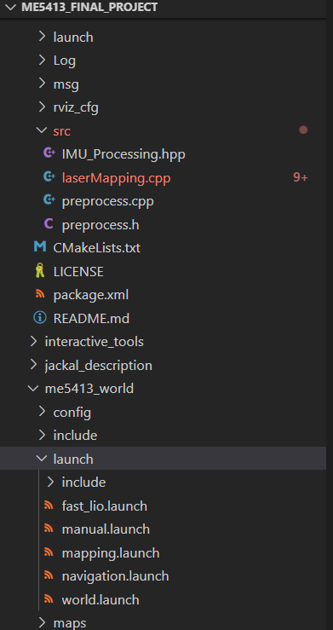
Task 1 Mapping
FAST-LIO Development
Figure 5. Screenshot of fast_lio.launch and ointcloud callback function in LaserMapping.cpp

Slide 6
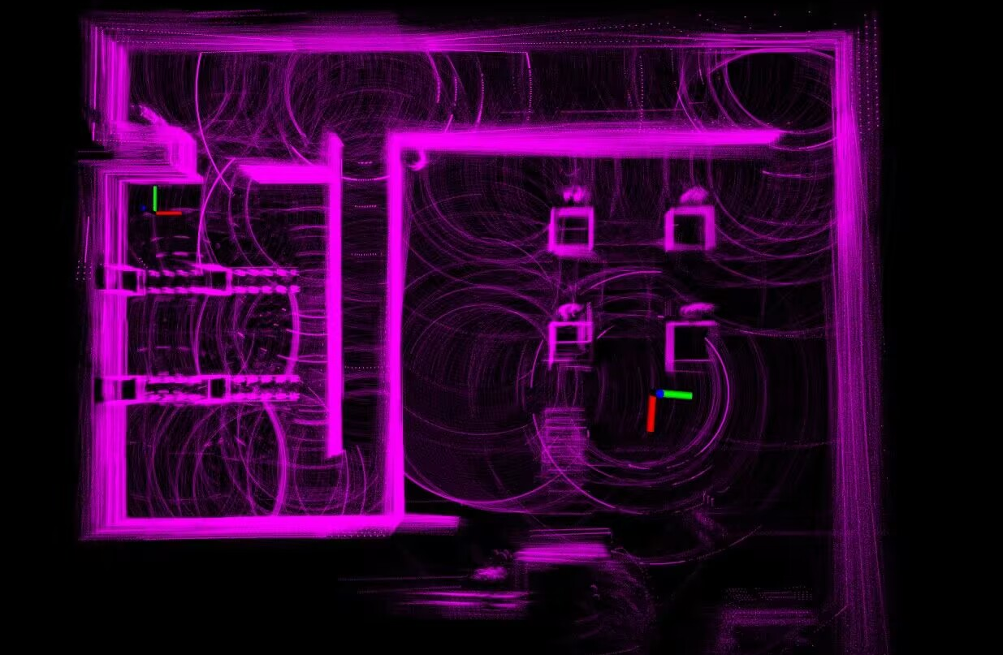
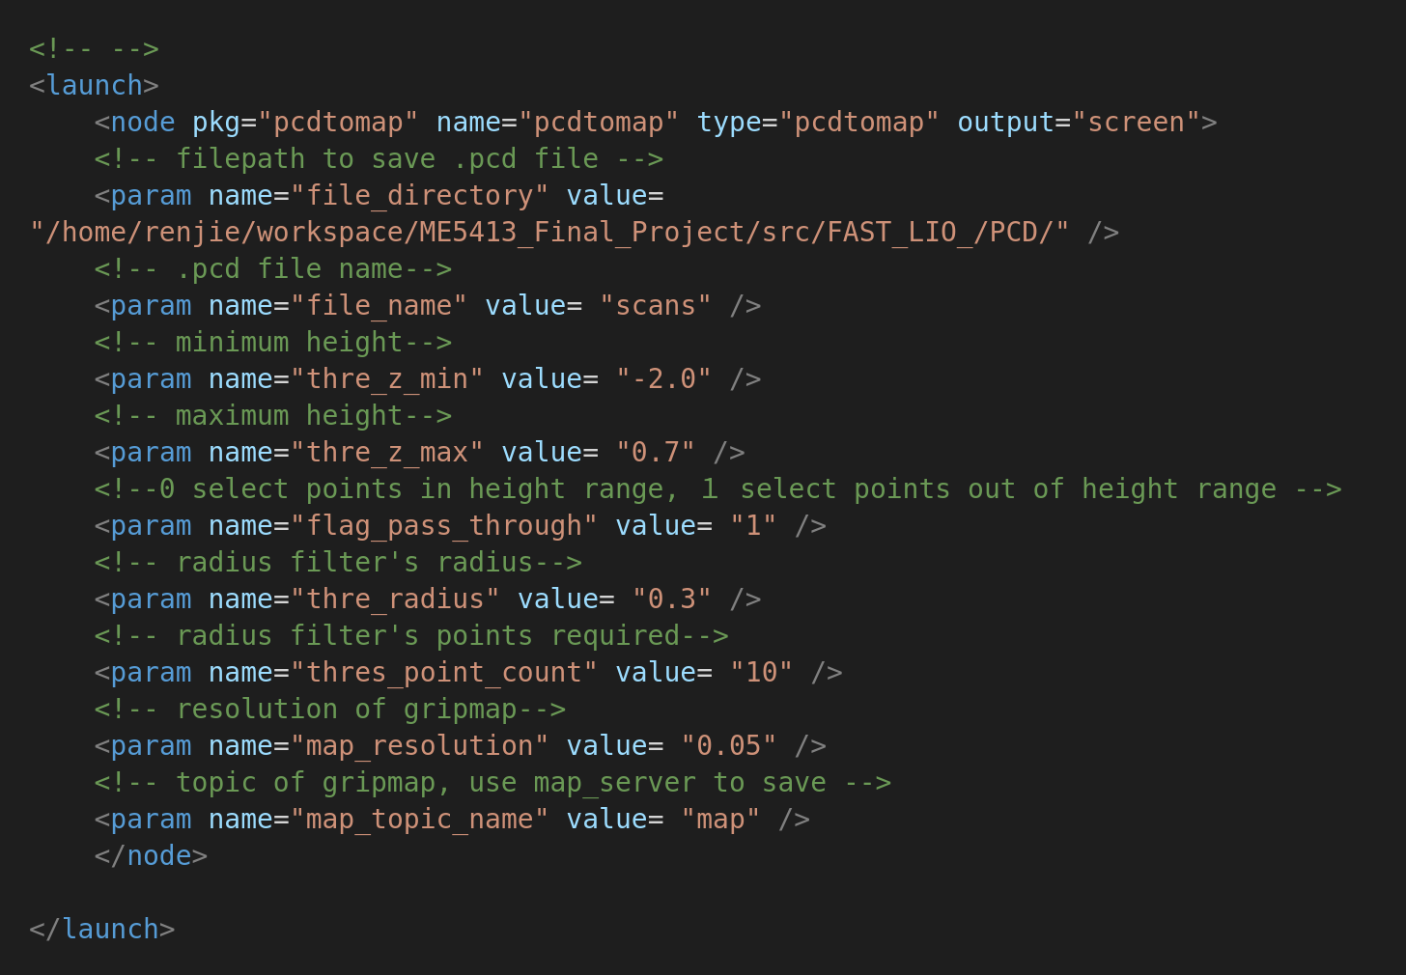
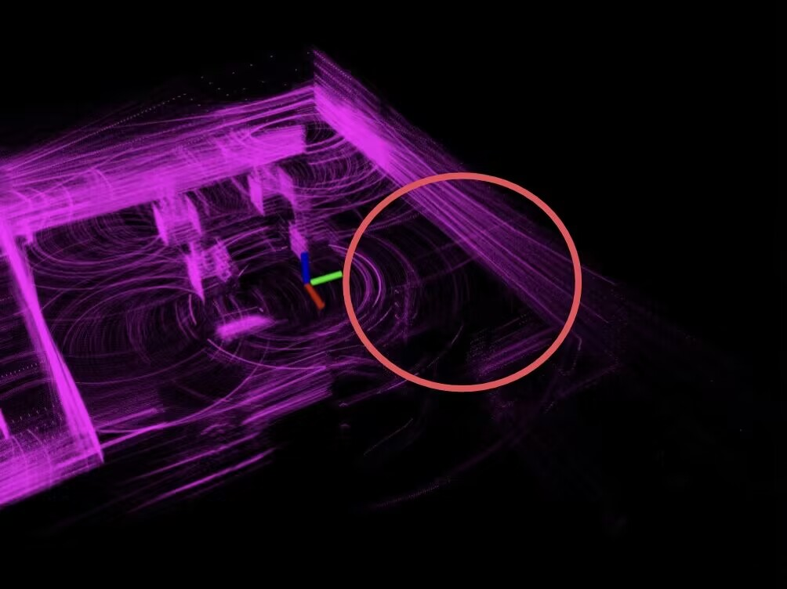
Task 1 Mapping
Filtering – pcdtomap.cpp
Figure 7. Problem: not cut off ground pointclouds
Figure 6. Screenshot of pcdtomap.launch
Figure 8. Problem: fail to coincide with original pointclouds

Slide 7
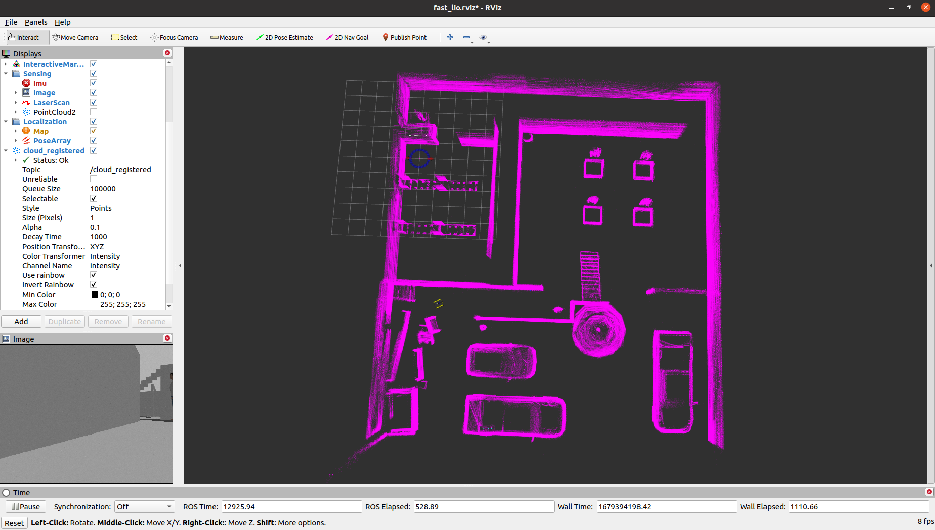
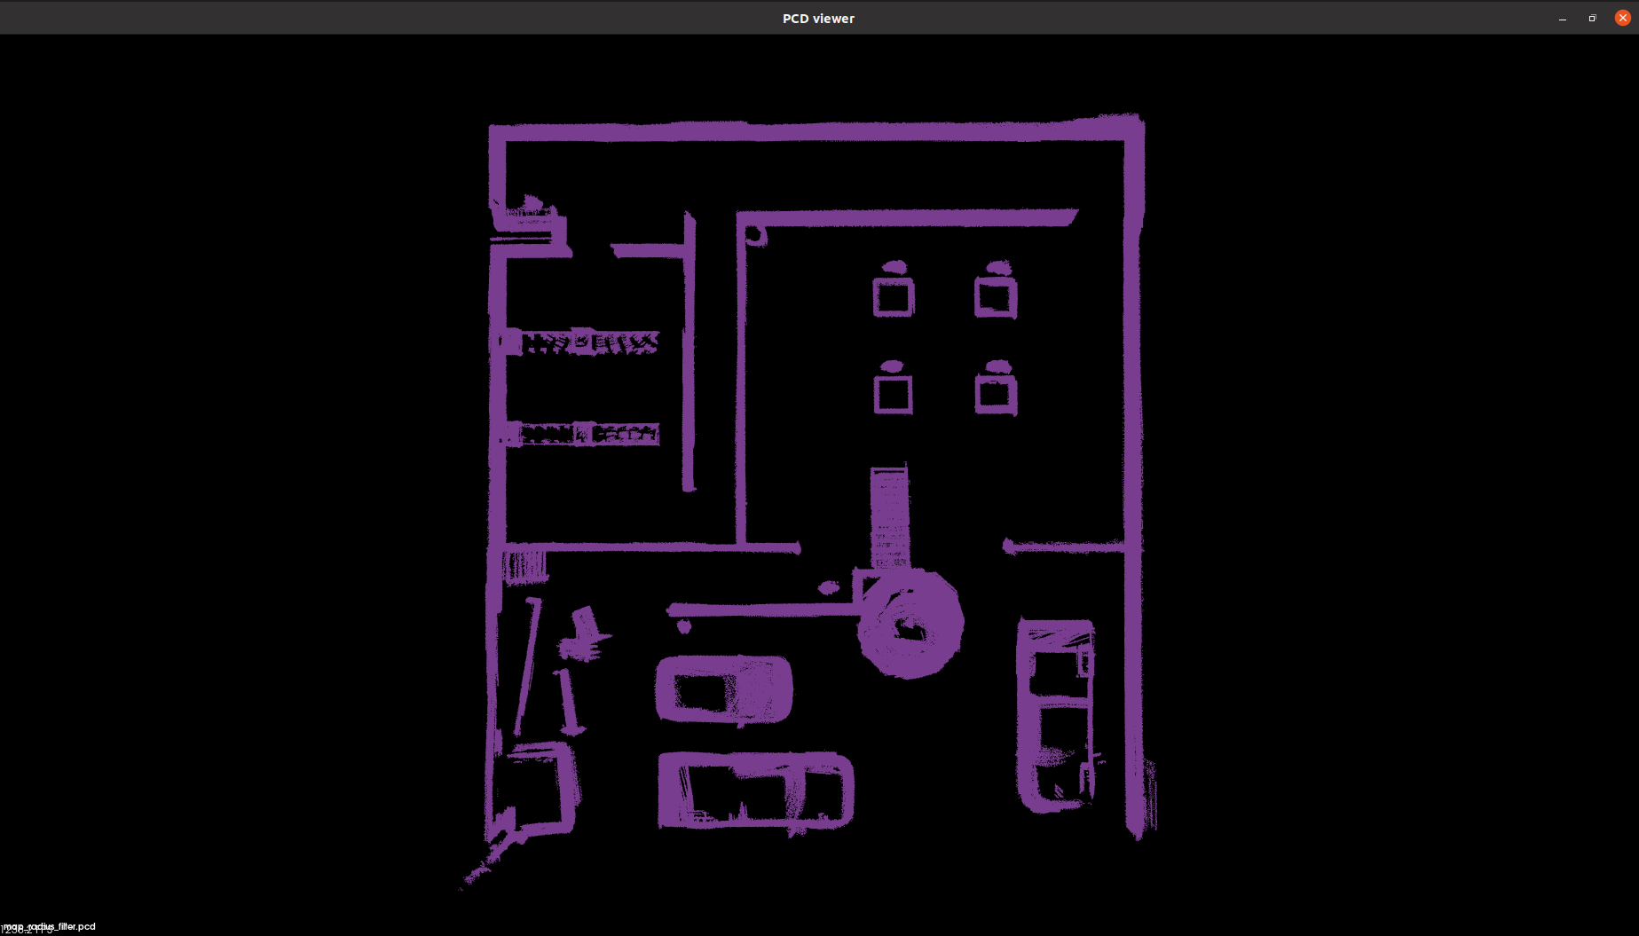
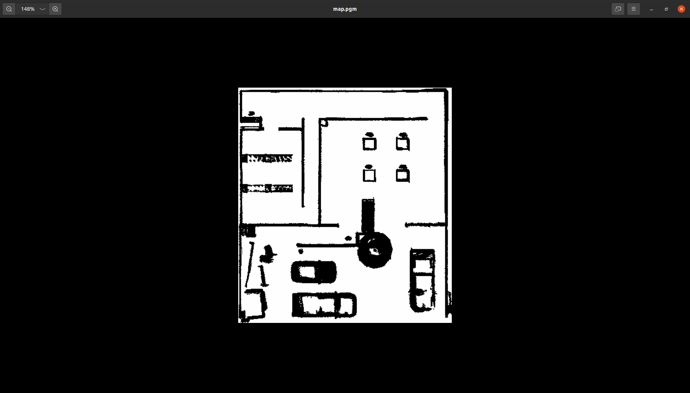
Task 1 Mapping
FAST-LIO (fusion of 3D LiDAR and IMU)
Mapping environment -> Filter pointclouds pcd -> Convert pcd to grid map
Figure 9. Schematic of mapping results

Slide 8
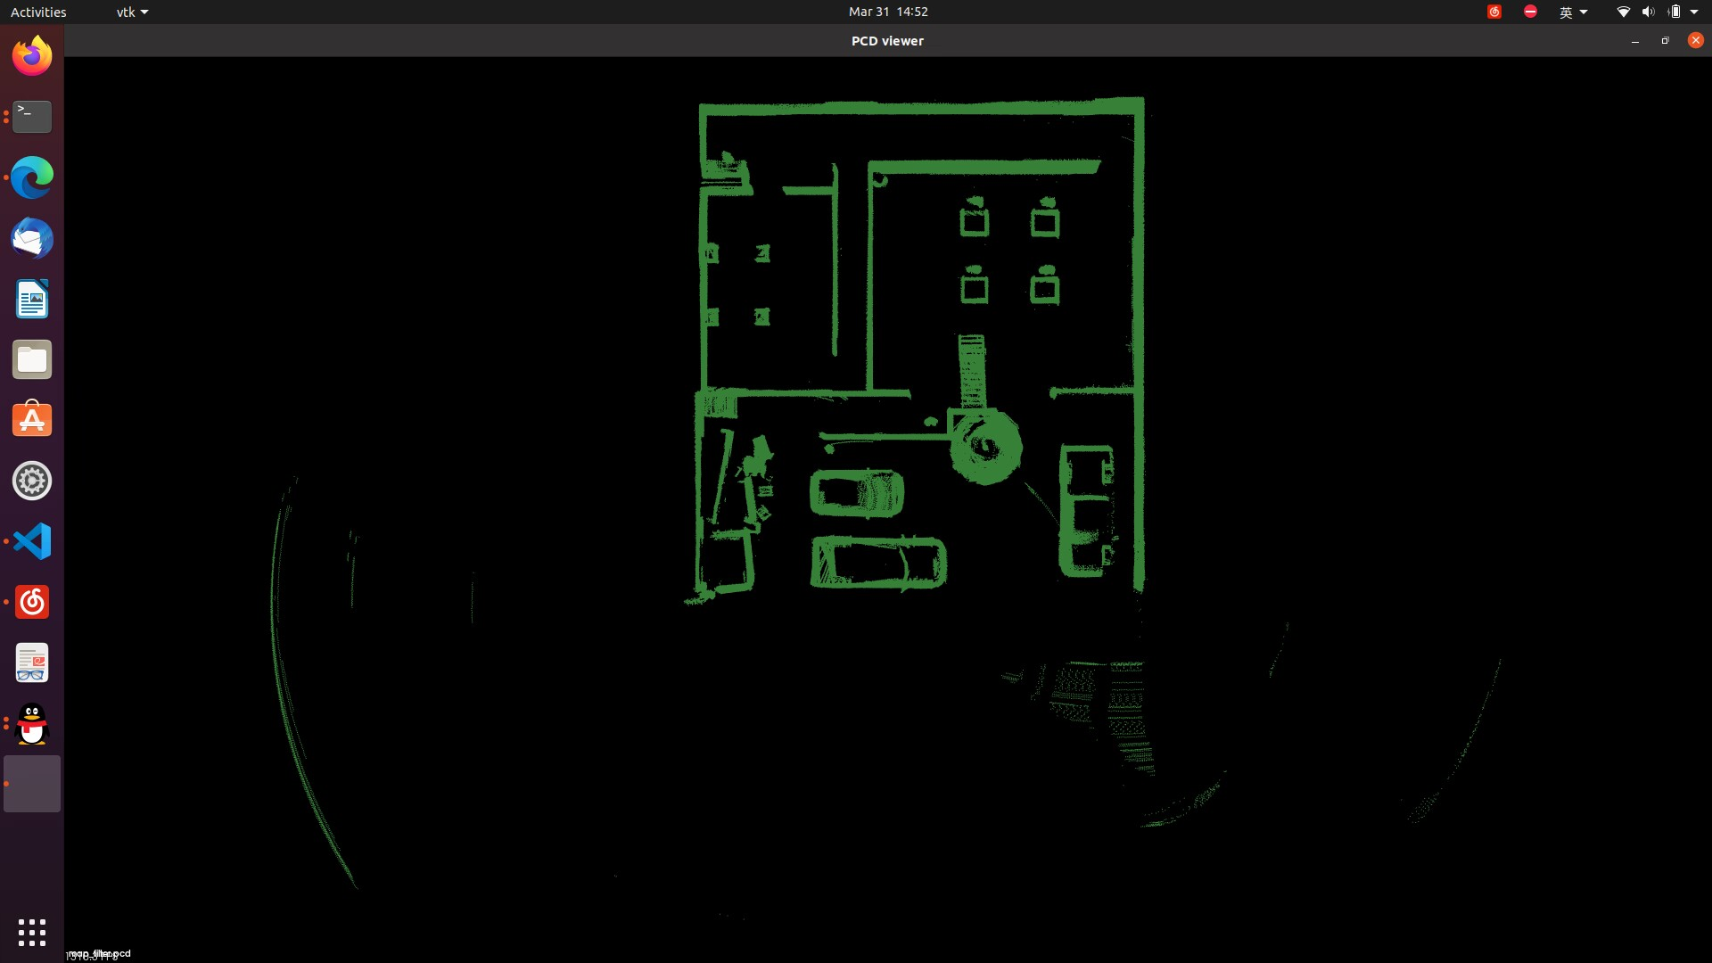
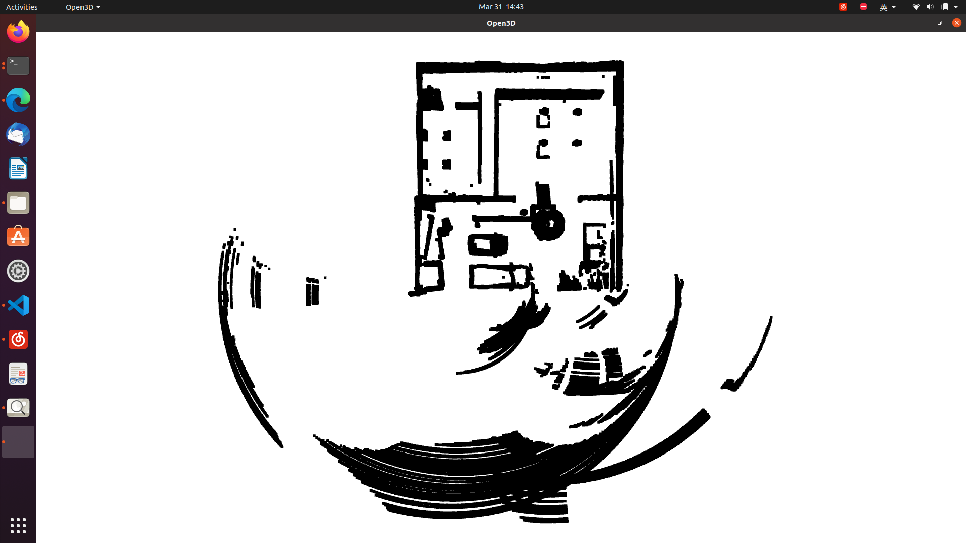
Task 1 Mapping
Comparison with 2D LiDAR mapping
Figure 10. Schematic of mapping results comparison (pass-through filter, RANSAC)

Slide 9
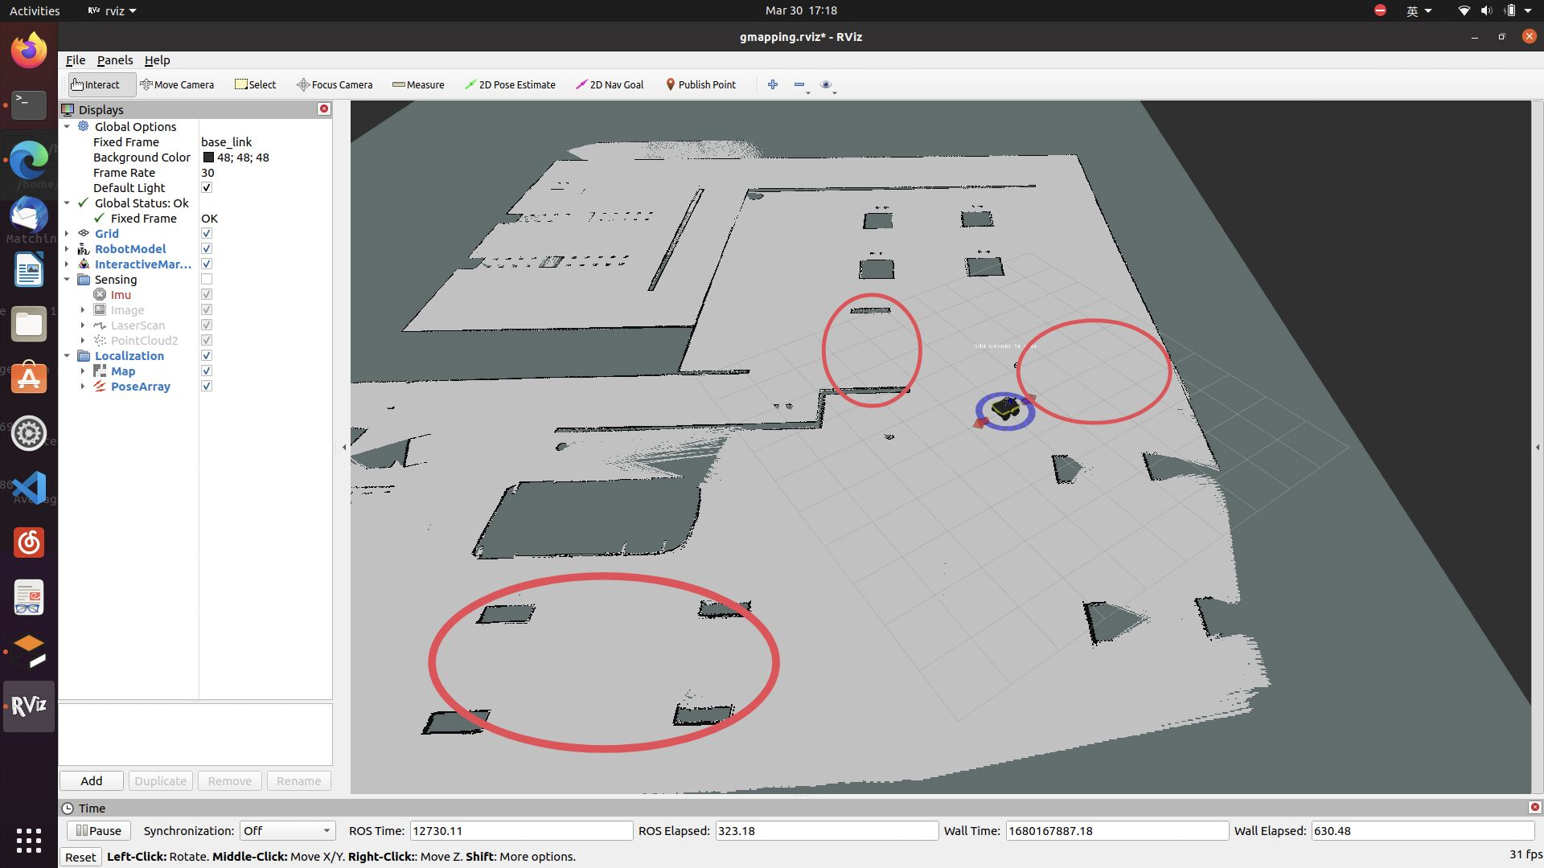
Task 1 Mapping
Comparison with 2D LiDAR mapping
Figure 11. Schematic of comparison with 2D mapping

Slide 10
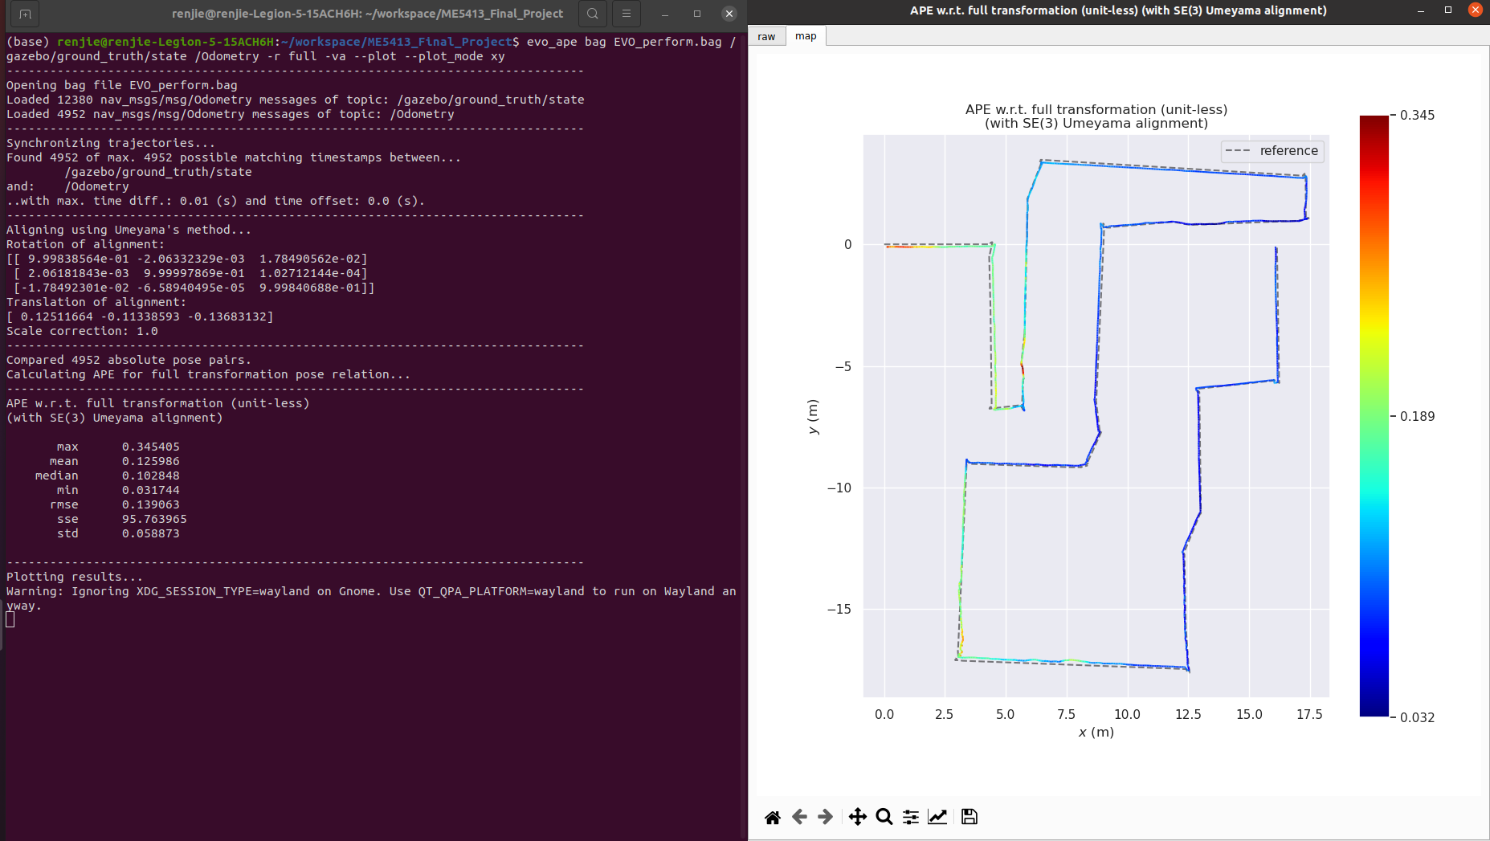
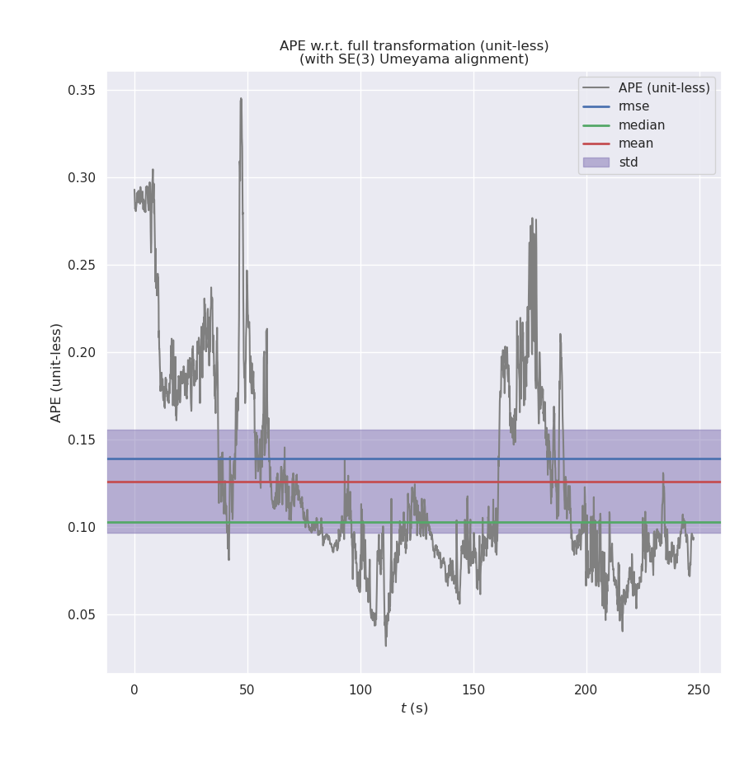
Task 1 Mapping
EVO Performance Evaluation
mean alignment is 0.125986
max alignment is 0.345405.
-> The results show that the accuracy of algorithm performs very good.
Figure 12. FAST-LIO accuracy performance using EVO

Slide 11
Task 1 Mapping
Challenges faced
Need to cut off ground cloudpoints.
Fail to coincide with original cloudpoints when turning Jackal.
Need to filter noise cloudpoints.
Need to convert pcd file to grid map for navigation.
Solutions
Add height limit for cloudpoints in callback function and add pass-through filter to filter ground points of pcd file.
Increase LiDAR rate from 10 Hz to 50 Hz.
Add radius filter to remove noise points.
Write algorithm package by ourselves to project pointclouds to 2D grid map.
Figure 7. Problem: not cut off ground pointclouds
Figure 8. Problem: fail to coincide with original pointclouds

Slide 12
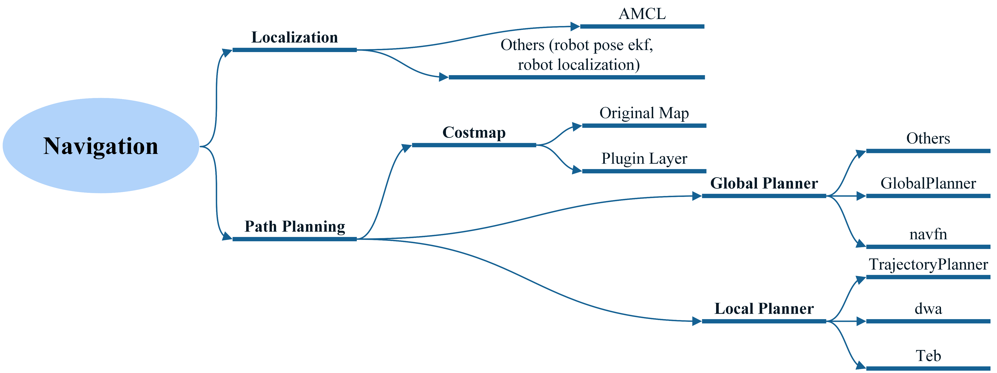
Task 2 Navigation
Figure 13. Schematic of navigation structure

Slide 13
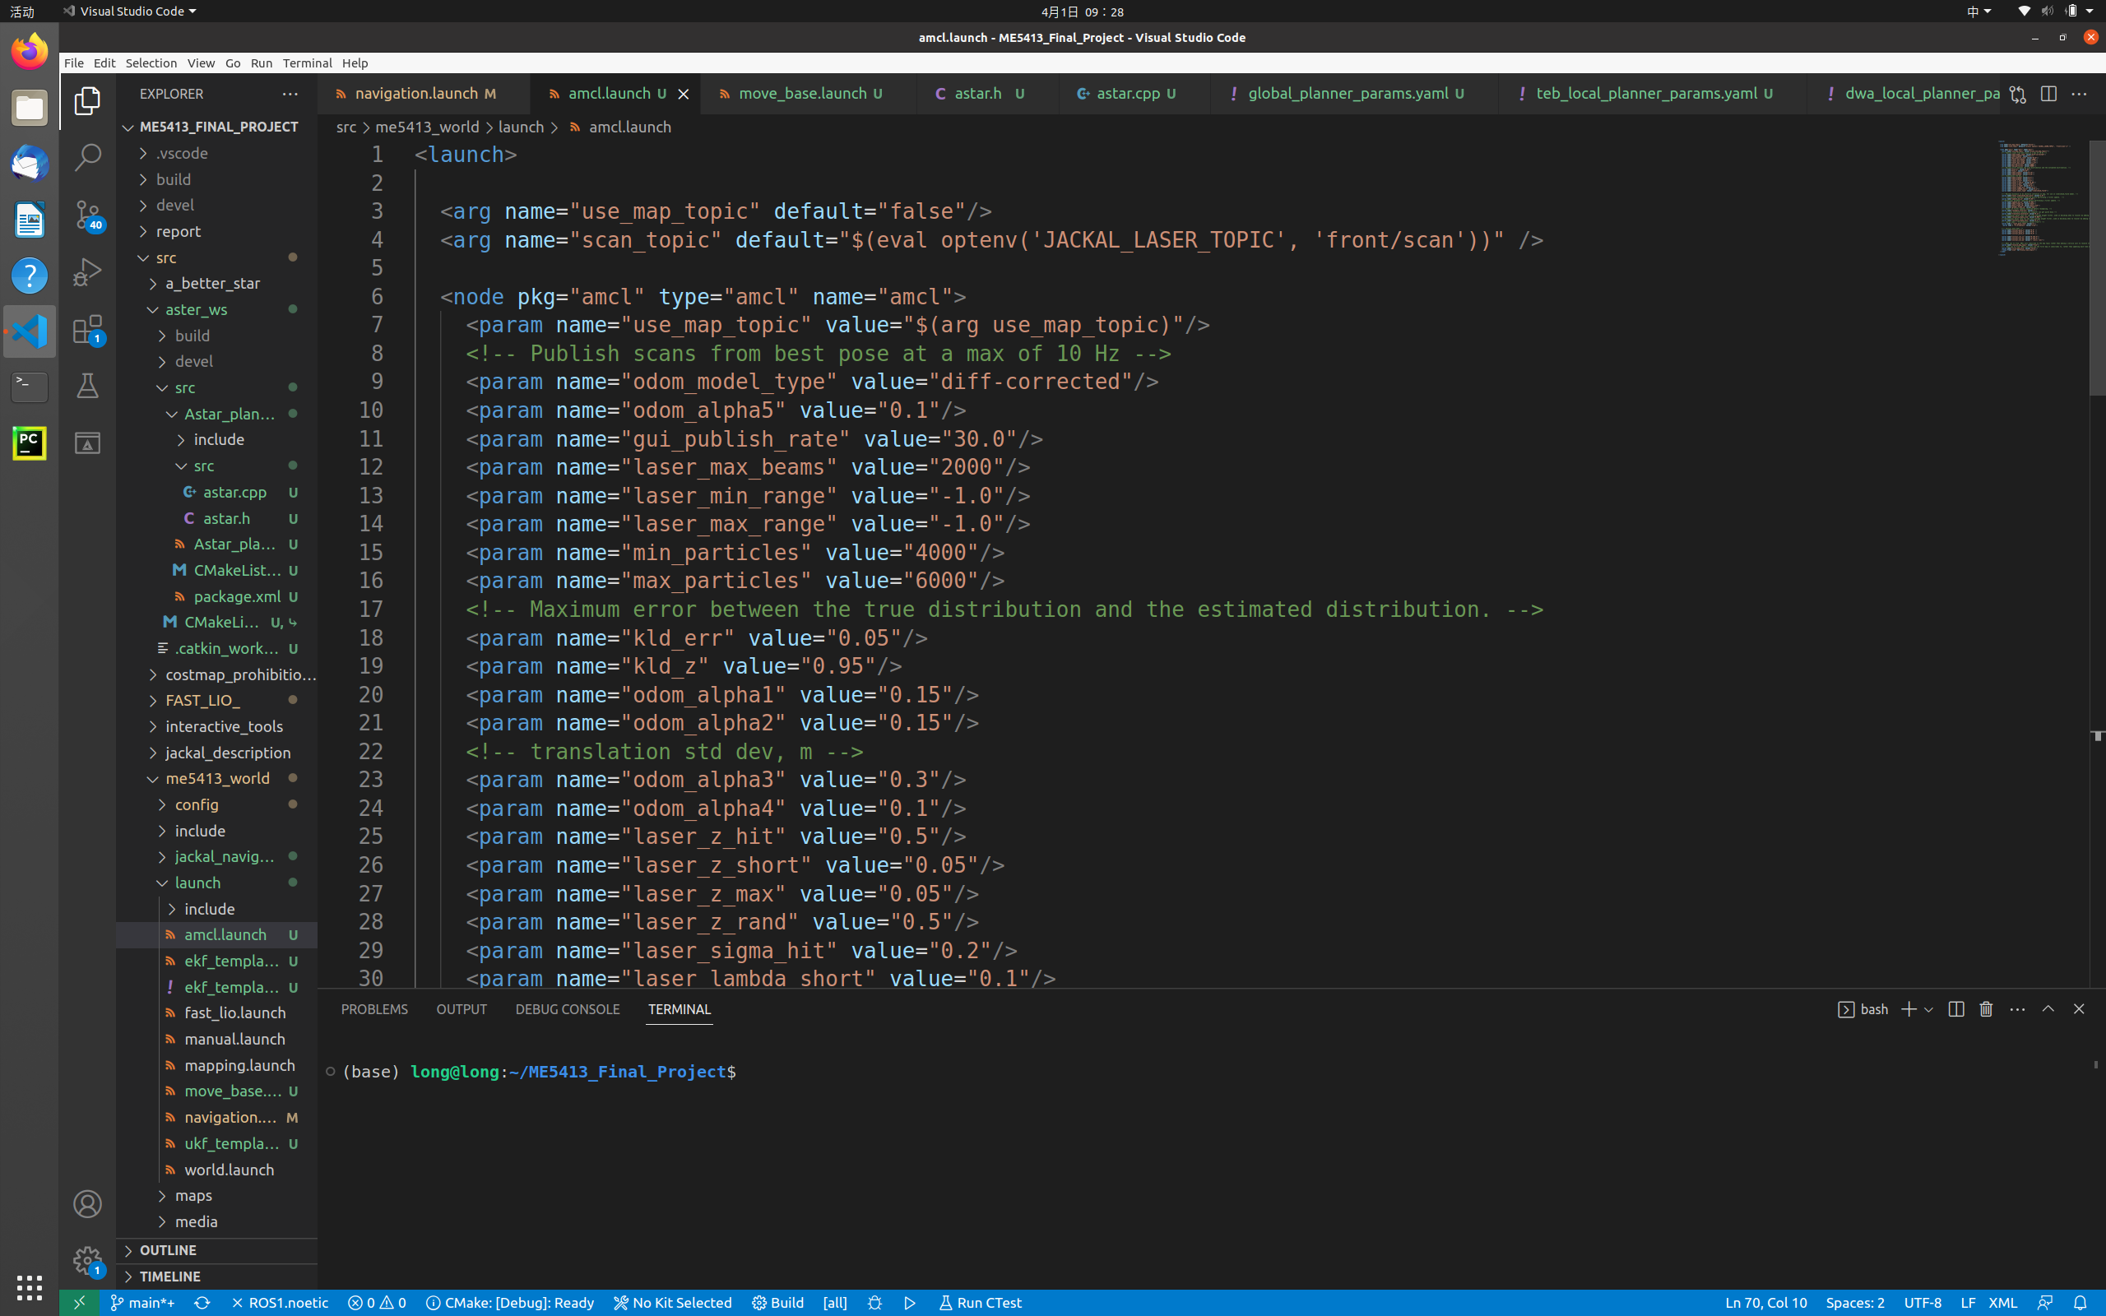
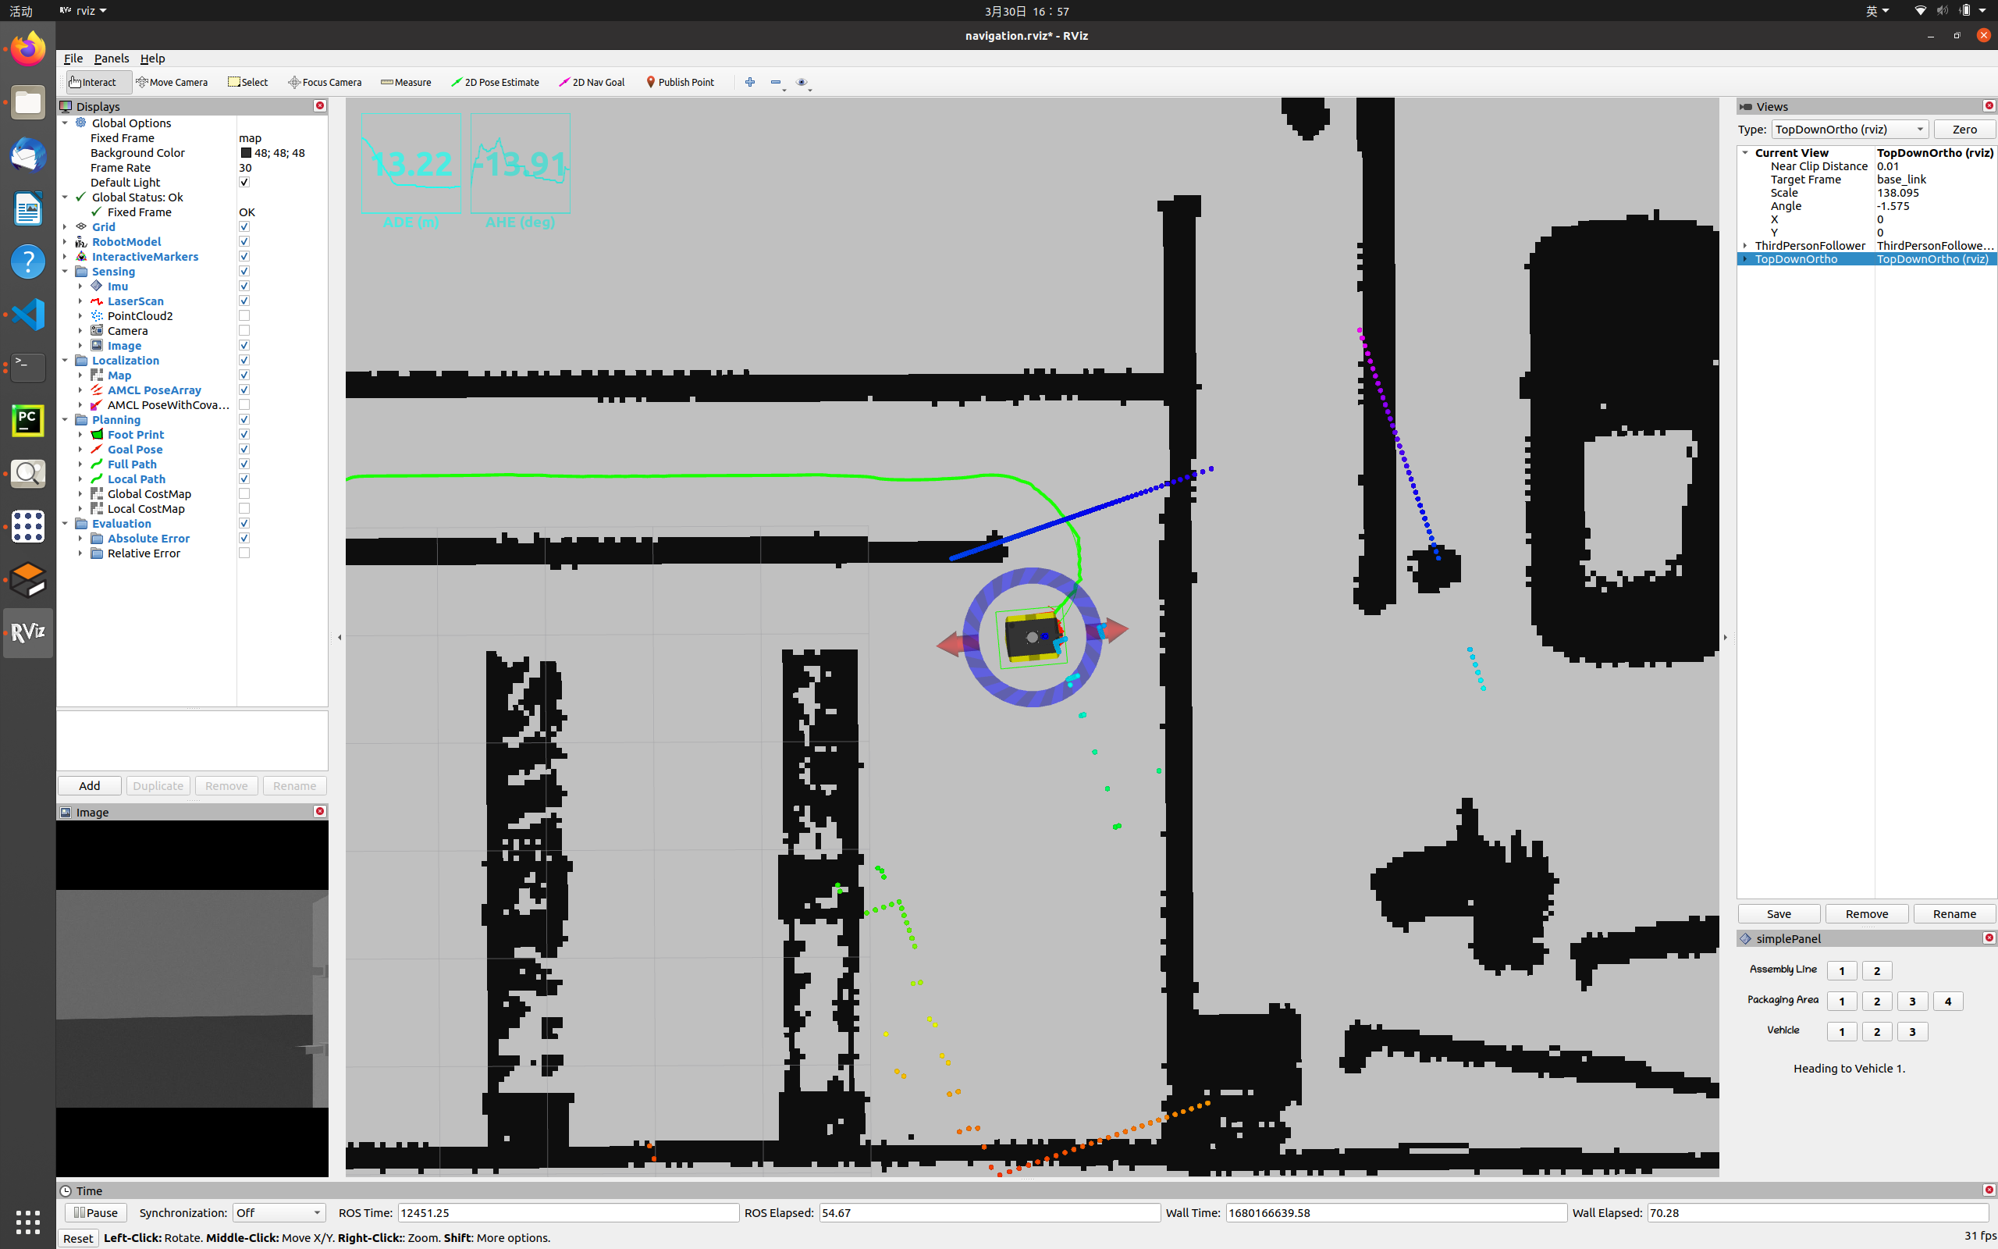
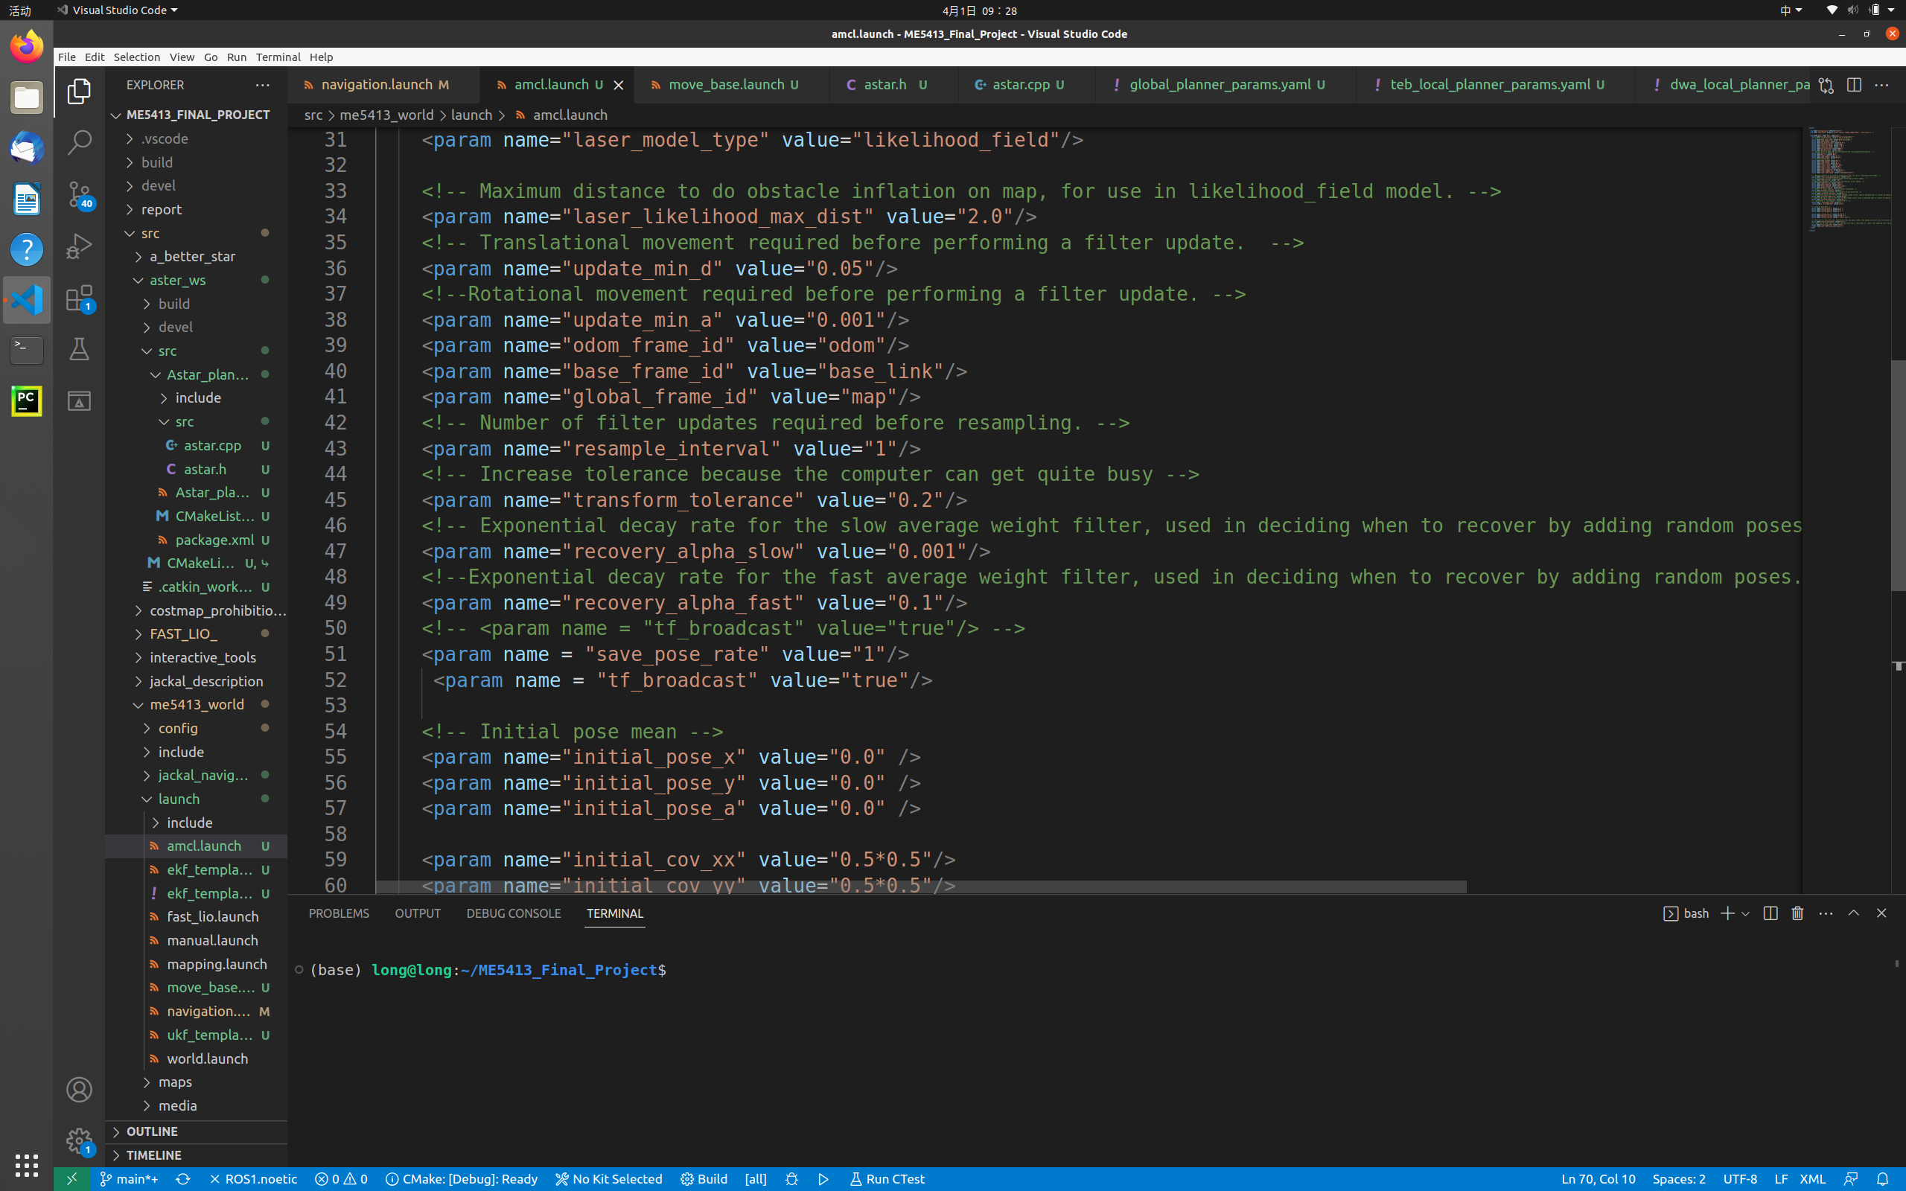
Task 2 Navigation-Localization
AMCL
Figure 14. Default amcl parameters
Figure 15. amcl params.yaml

Slide 14
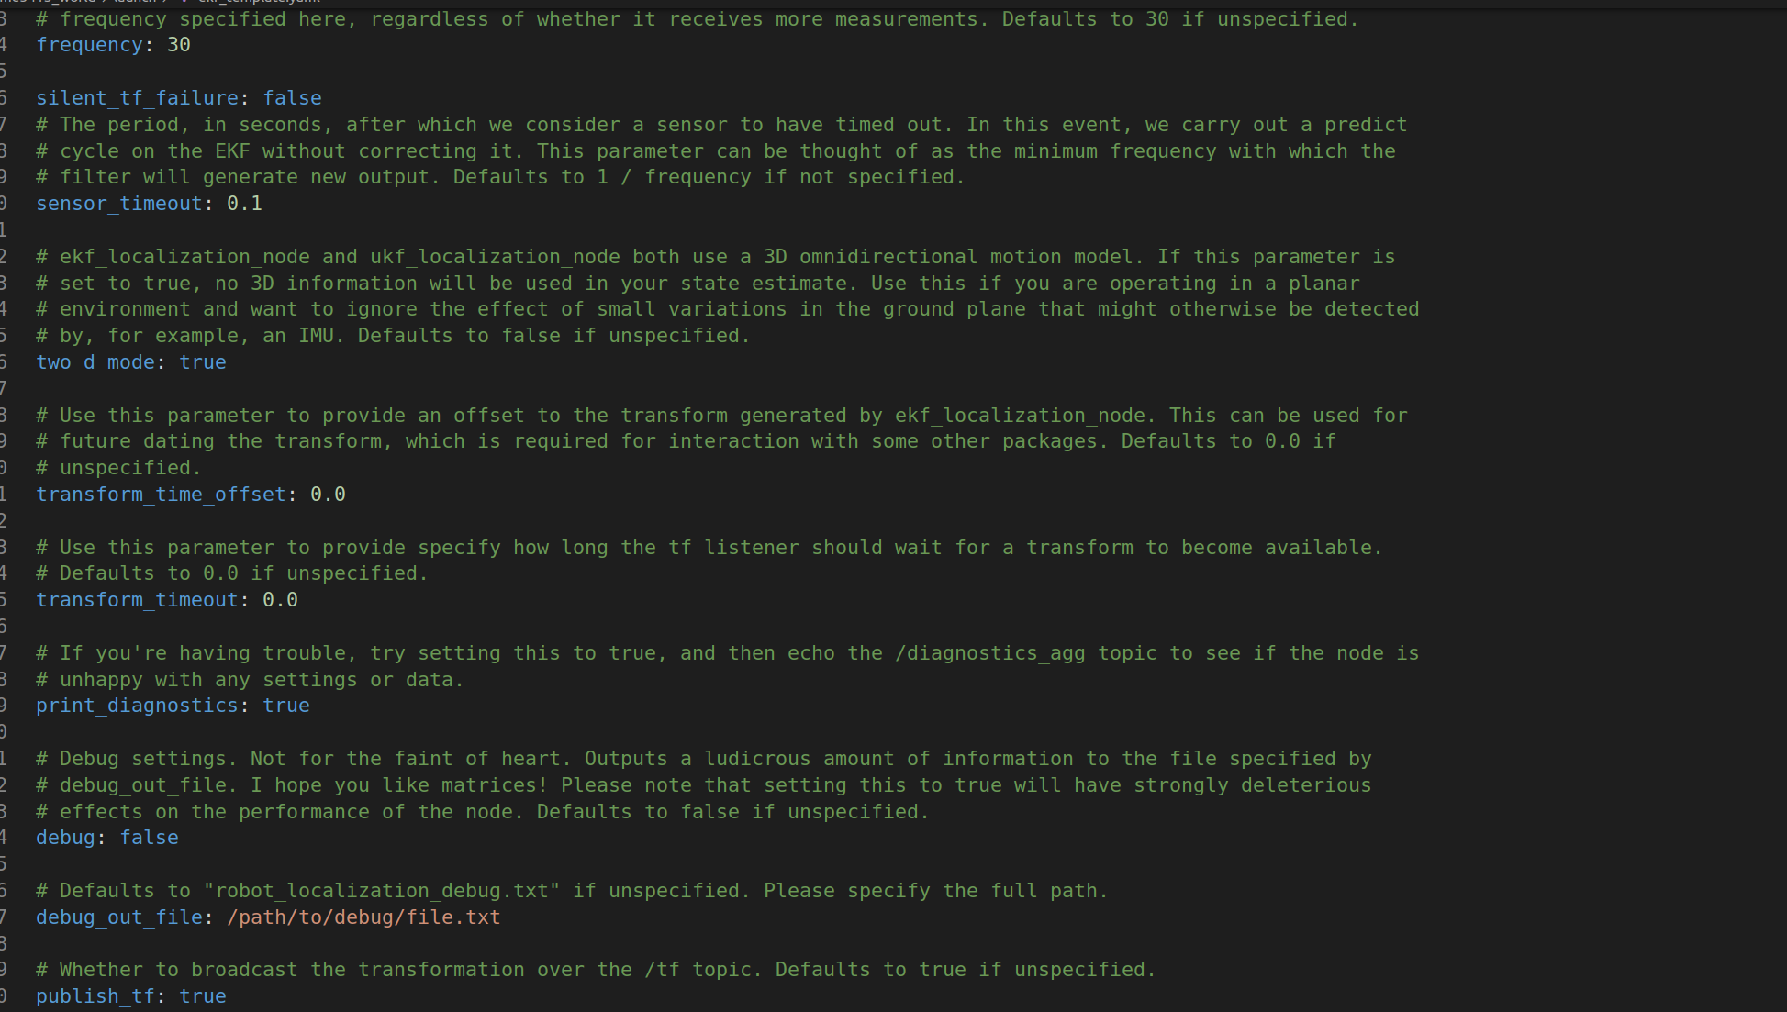
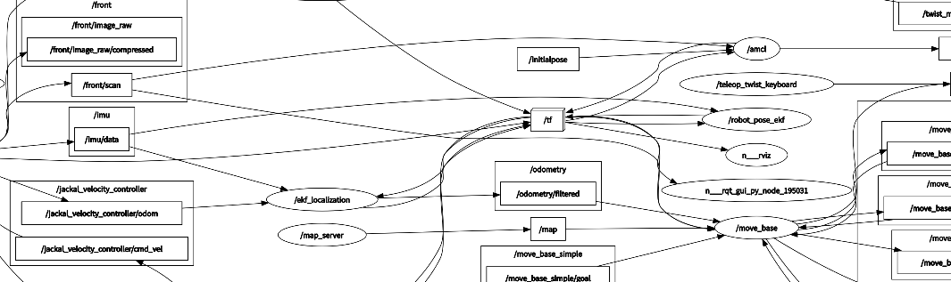
Task 2 Navigation-Localization
Other Localization
Figure 16. ekf_template_params.yaml
Figure 17. Schematic of node graph of GlobalPlanner

Slide 15
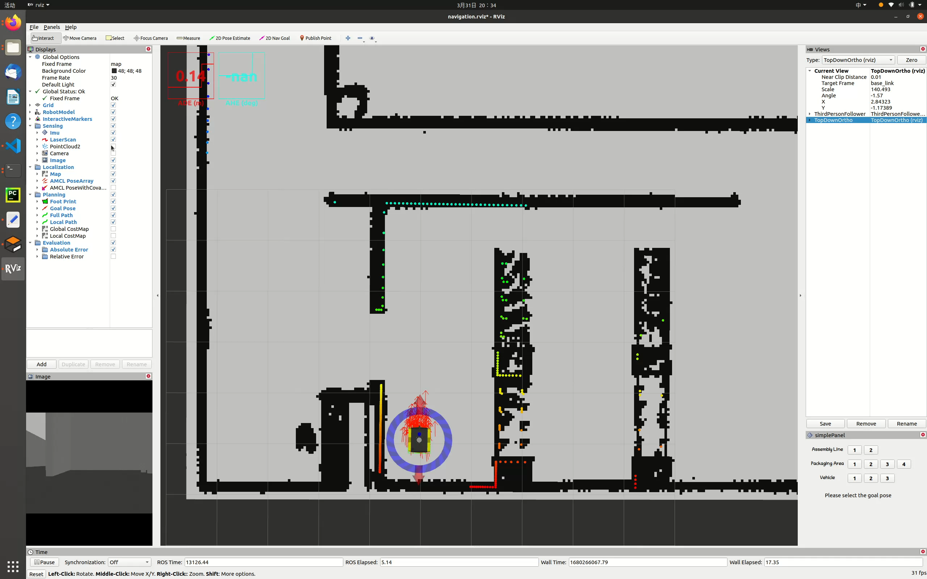
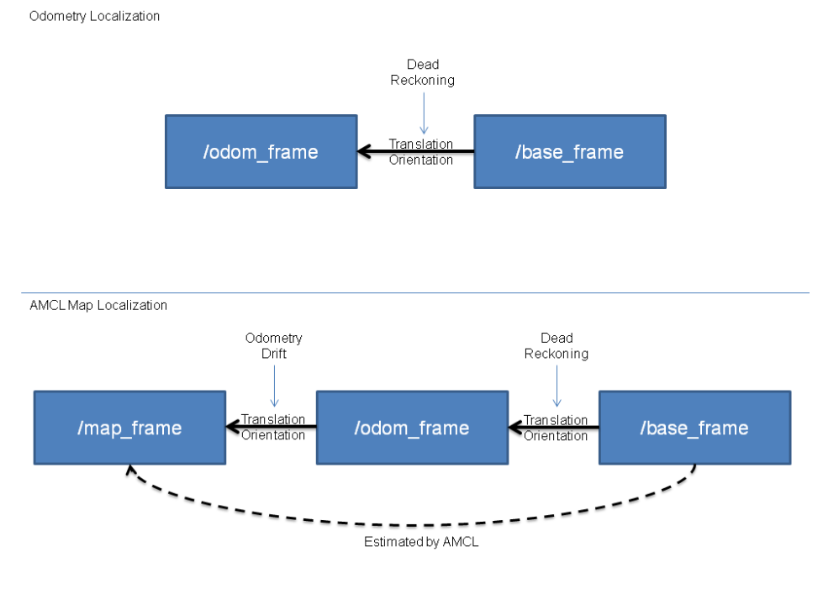
Task 2 Navigation-Localization
Frame drifting problem
Figure 18. Odometry localization
AMCL map localization

Slide 16
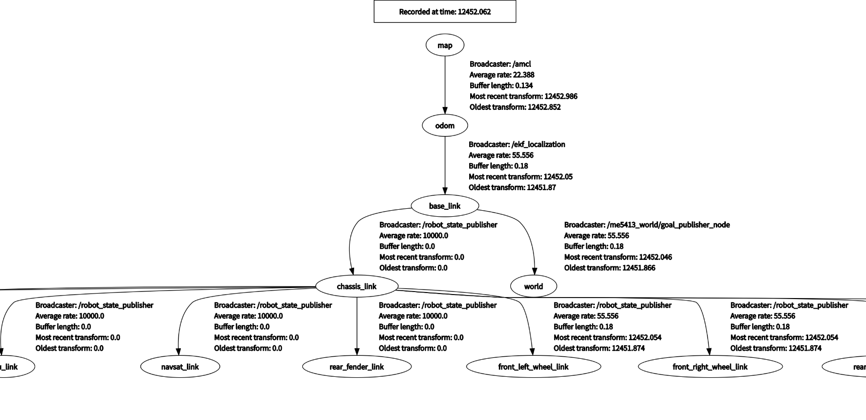
Task 2 Navigation-Localization
Frame drifting problem
Figure 19. Schematic of partial TF tree of robot

Slide 17
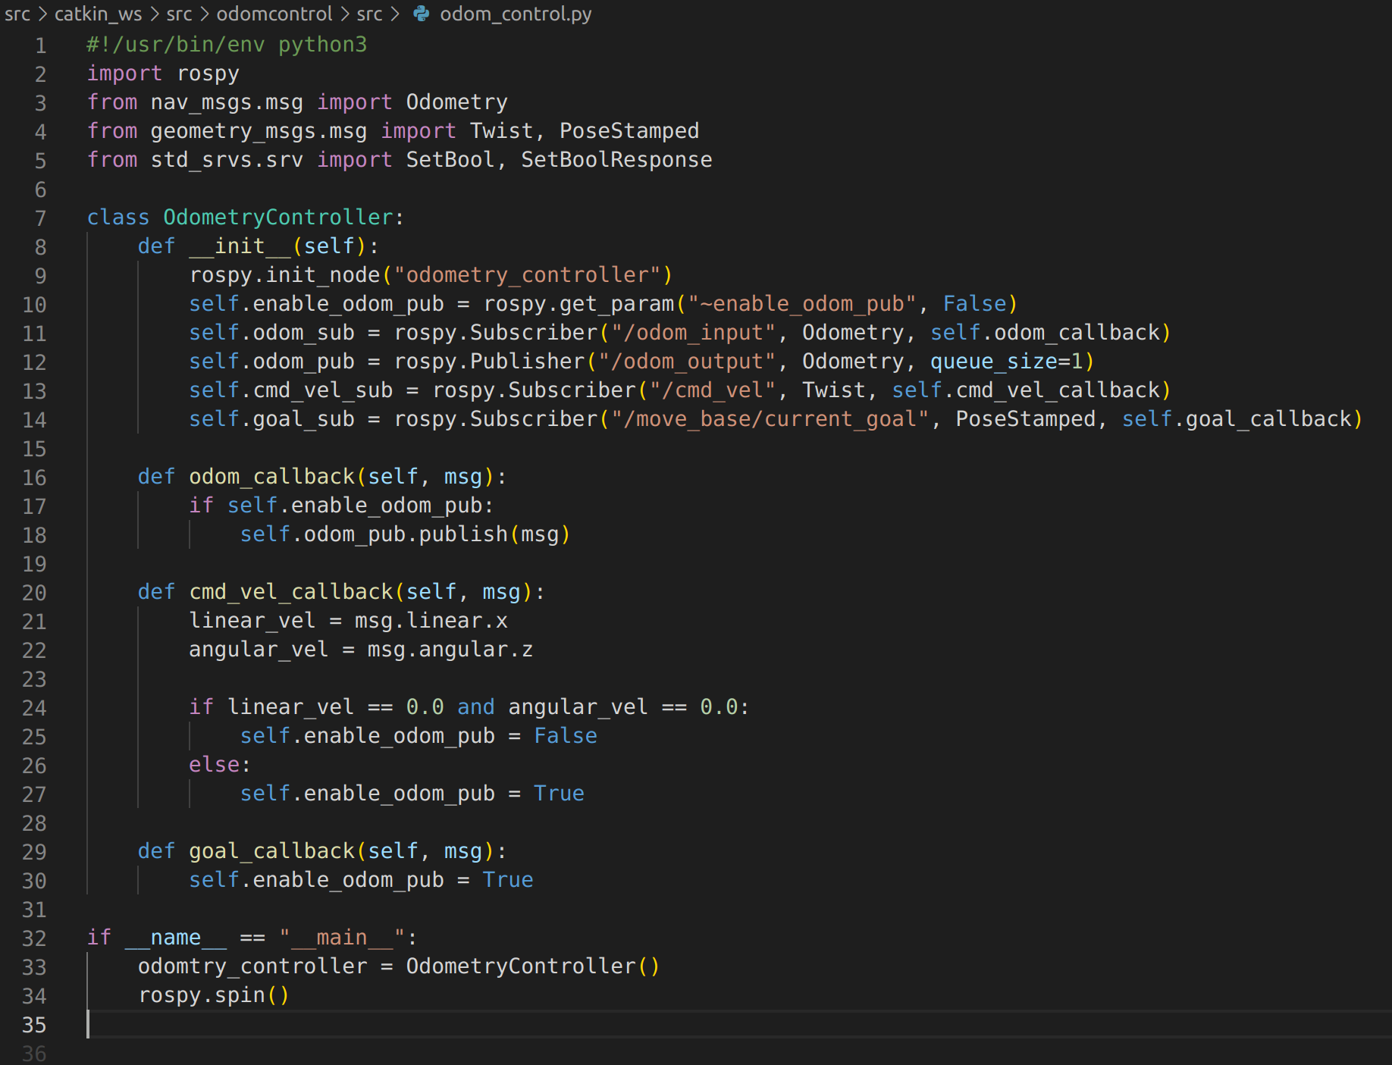
Task 2 Navigation-Localization
Frame drifting problem
Figure 20. odom_control.py
Figure 21.AMCL params

Slide 18
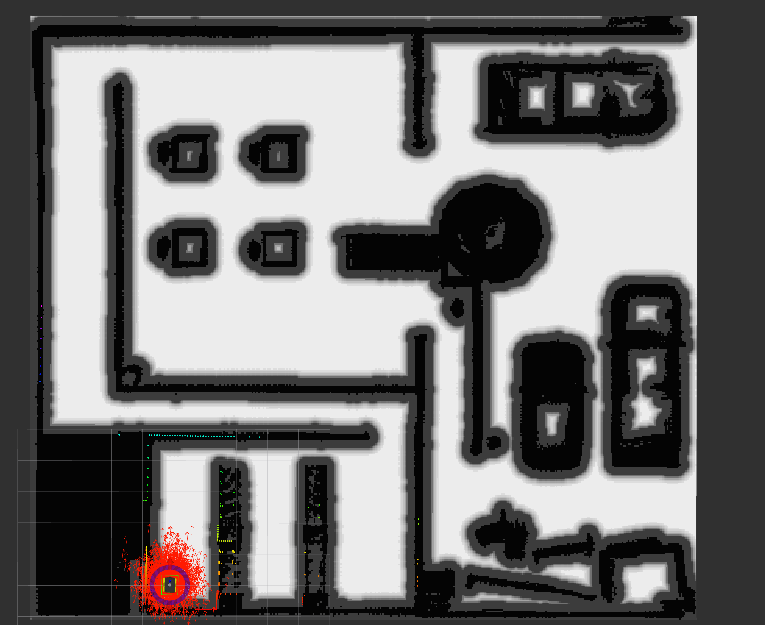
Task 2 Navigation-Planning
Costmap - Changing original map
Figure 22. Costmap by changing original map

Slide 19
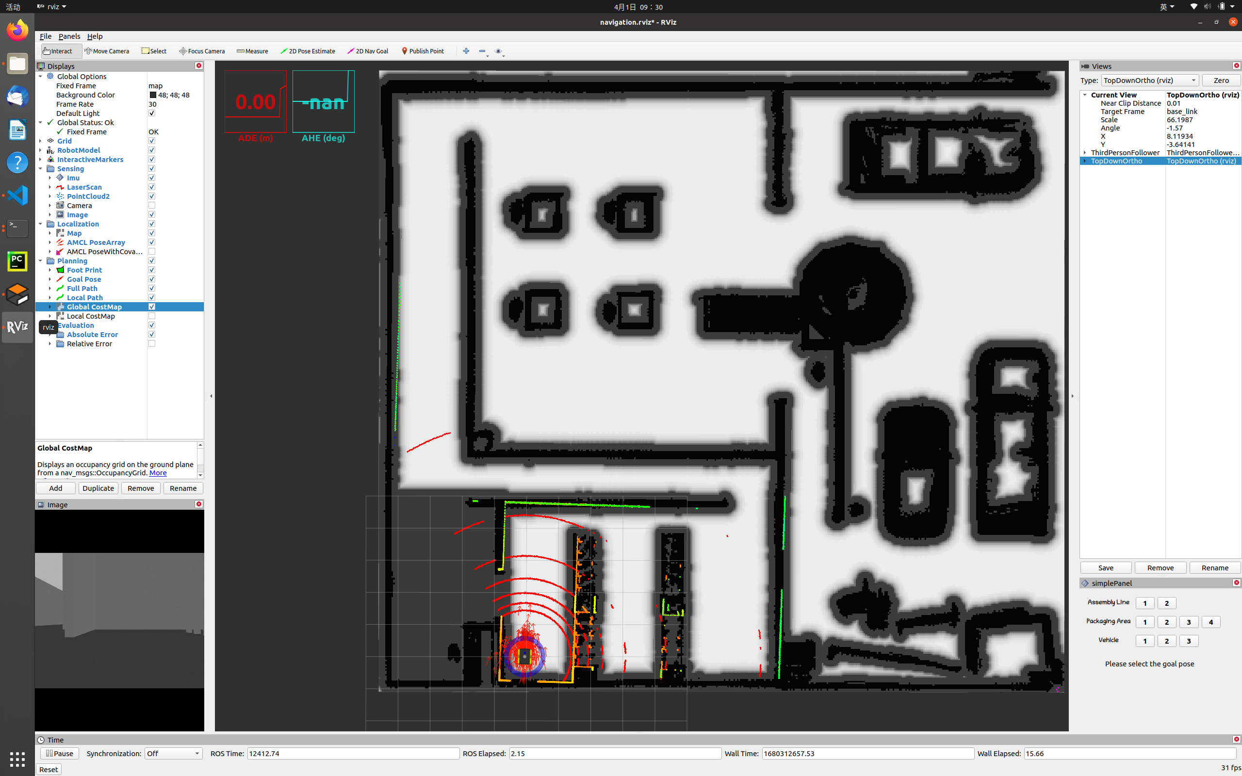
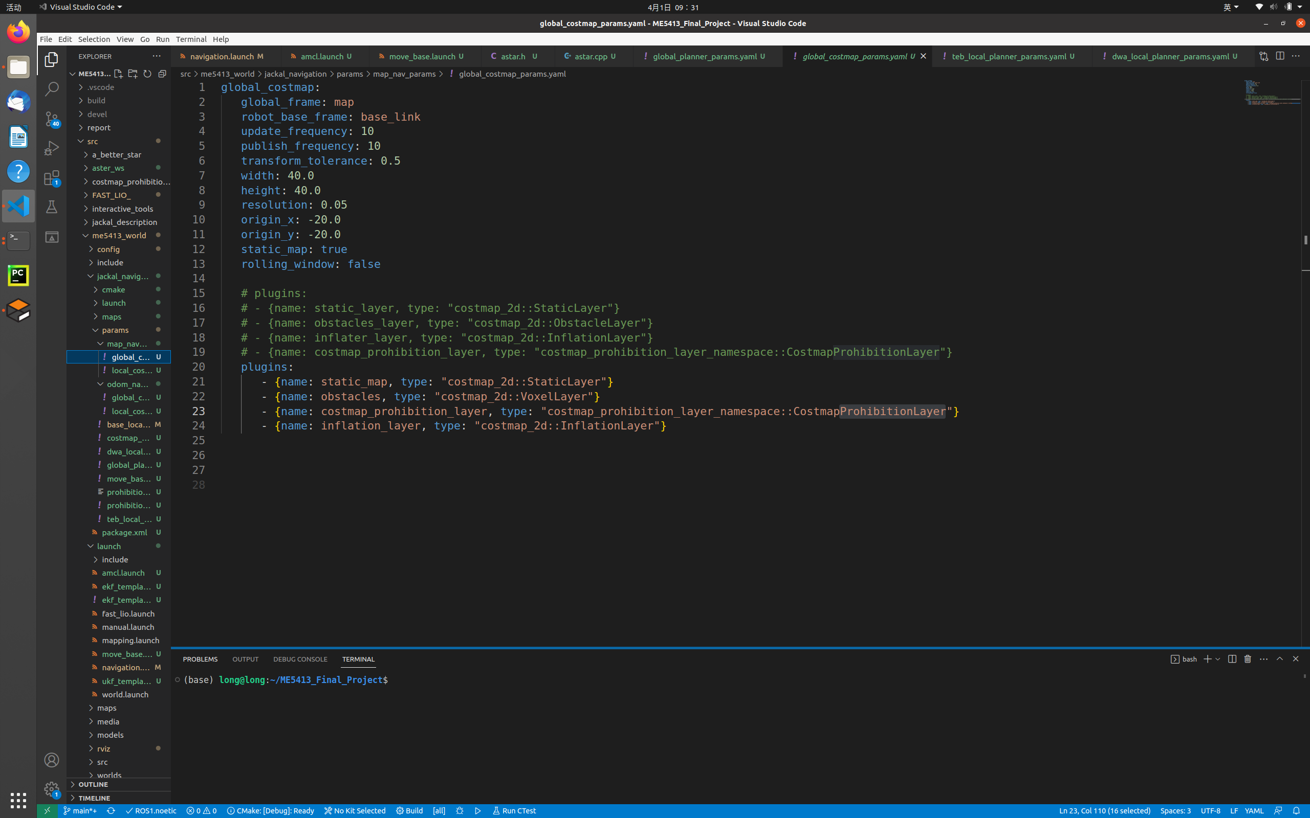
Task 2 Navigation-Planning
Costmap-plugin layer
Figure 23. Costmap by plugin prohibition layer
Figure 24. global_costmap_params.yaml

Slide 20
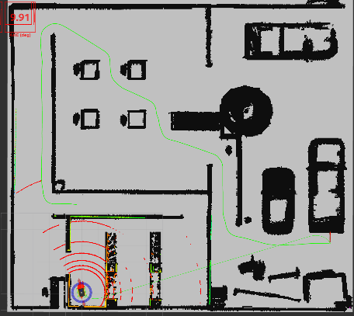
Task 2 Navigation-Planning
Global Planning-navfn
Has a path limitation, cannot create long distance path completely.
Solution: Change other Planners
GlobalPlanner
A better Star
Others
Figure 25. schematic of path shortage in navfn planner

Slide 21
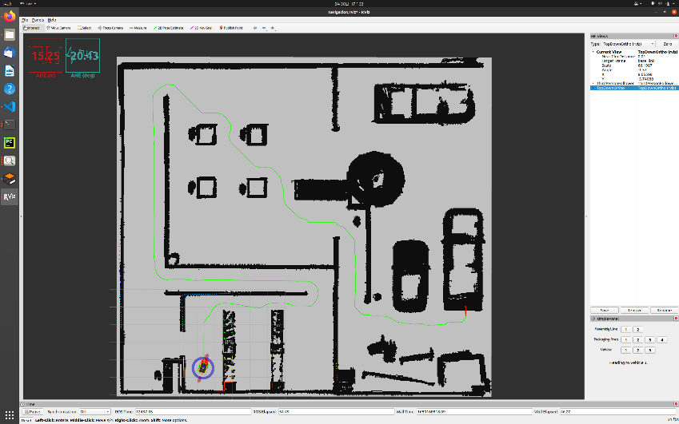
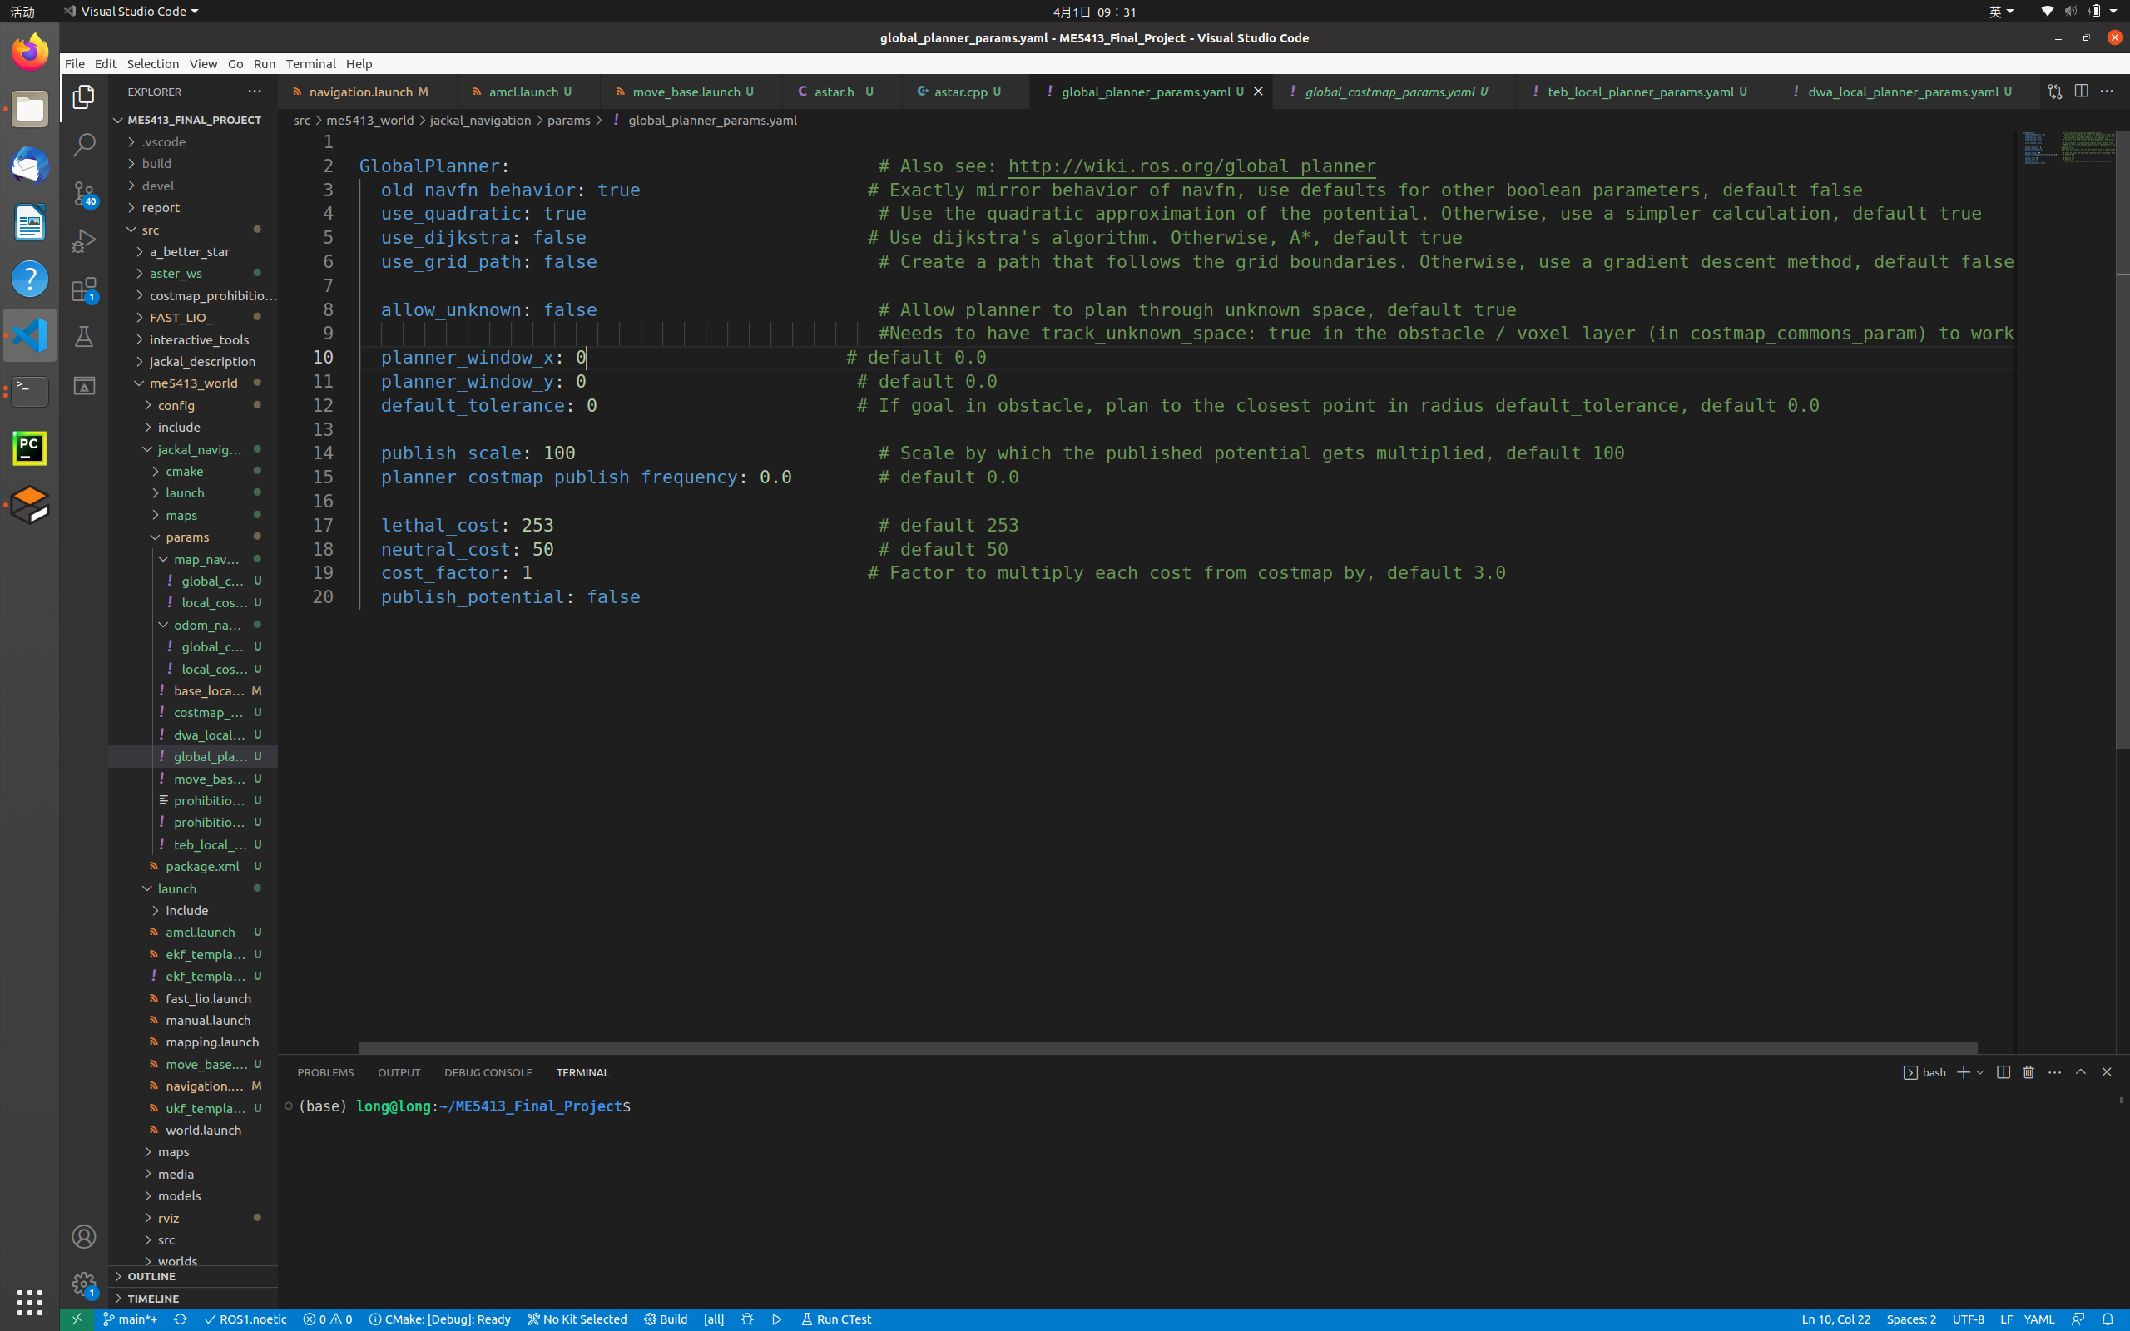
Task 2 Navigation-Planning
Global Planning-GlobalPlanner
Figure 27. global_planner_params.yaml
Figure 26. Complete path generated by GlobalPlanner

Slide 22
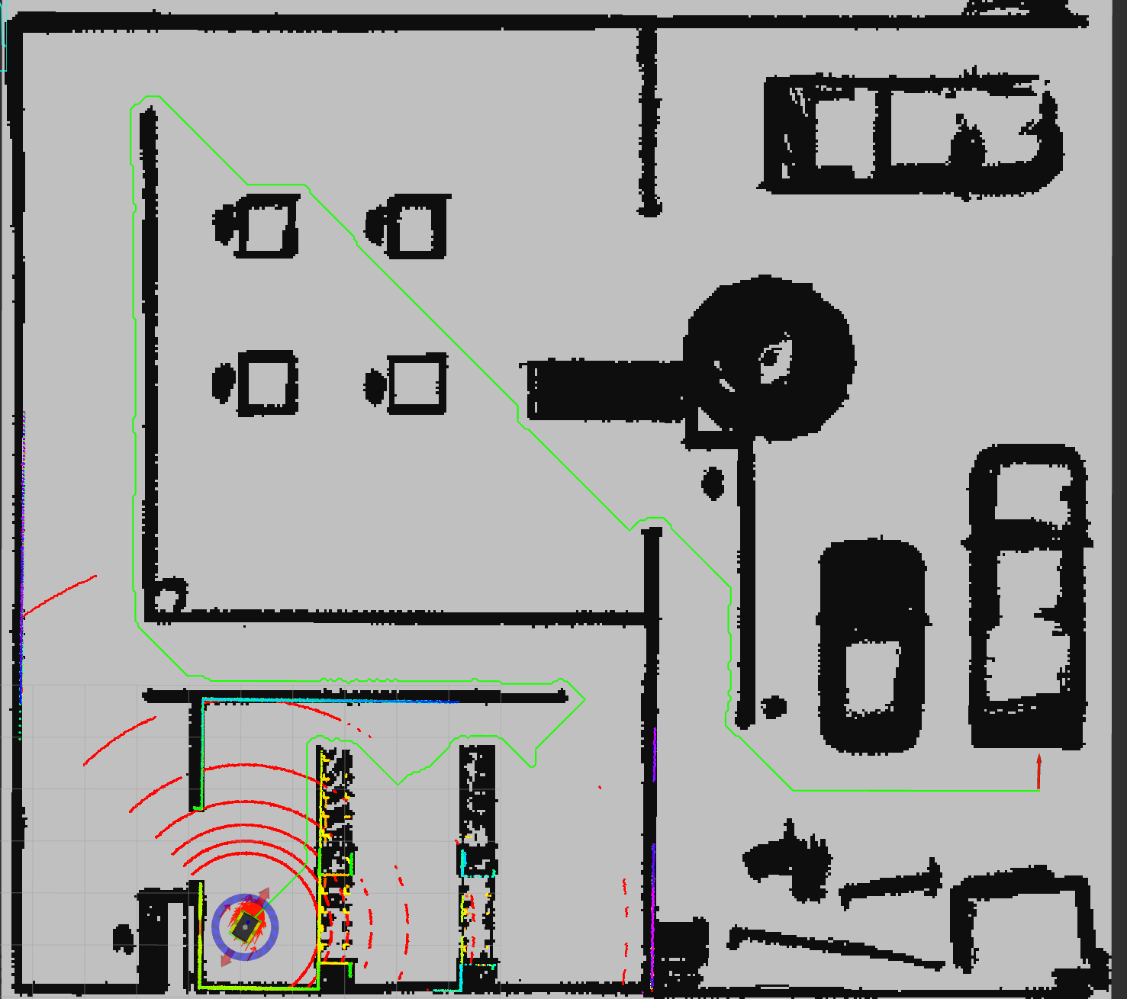
Task 2 Navigation-Planning
Global Planning-Other
Create workspace
Change CMakeLists
Implement algorithm in .cpp and .h files
Catkin_make
Create and change .xml file
Figure 28. Long path generated by Astar

Slide 23
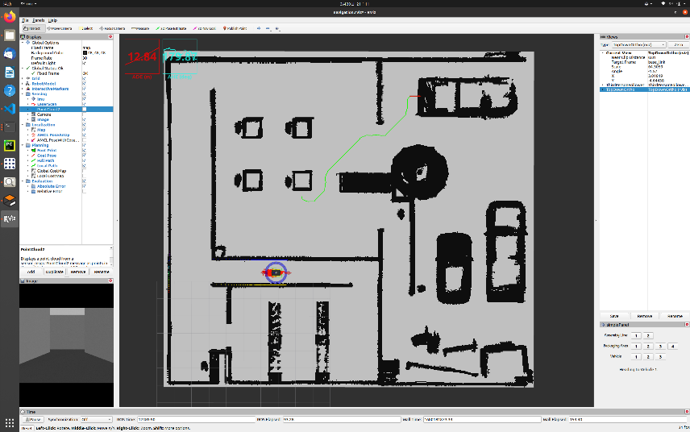
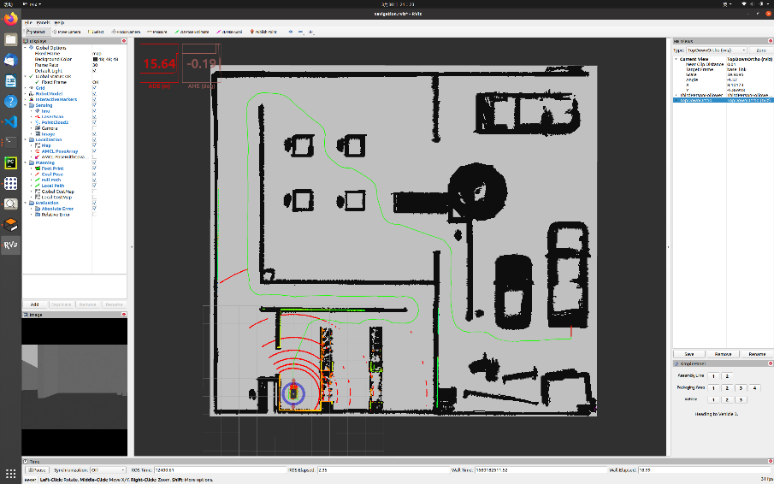
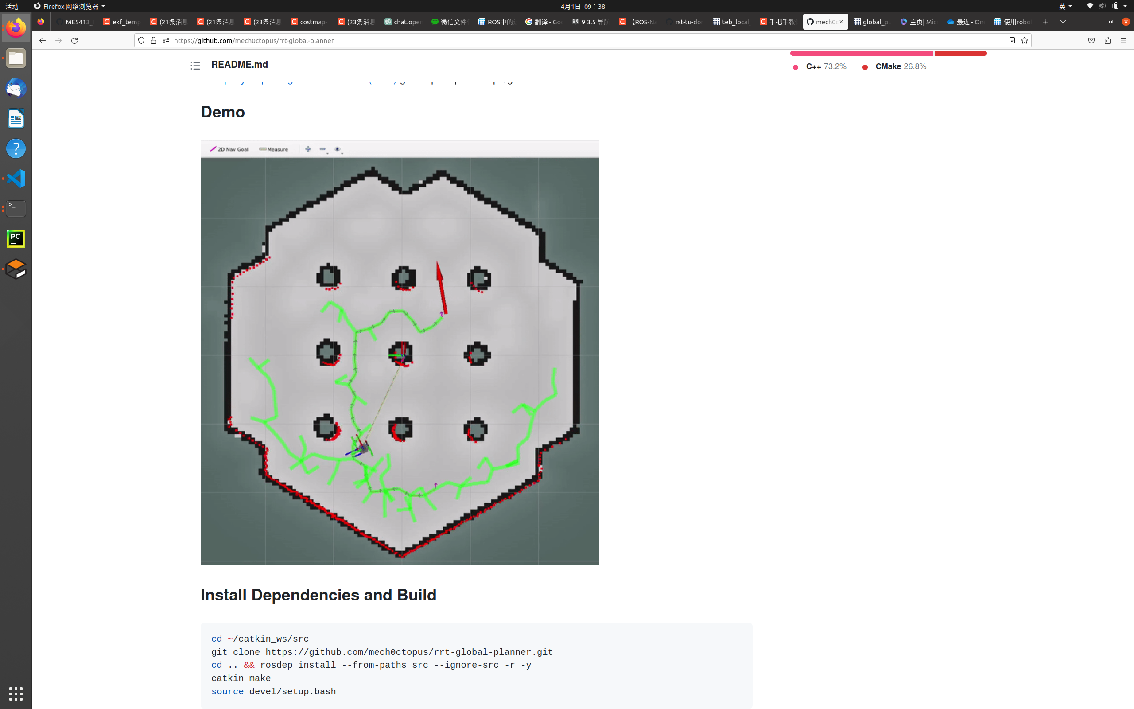
Task 2 Navigation-Planning
Global Planning-Other
Figure 29. Other global planning algorithms

Slide 24
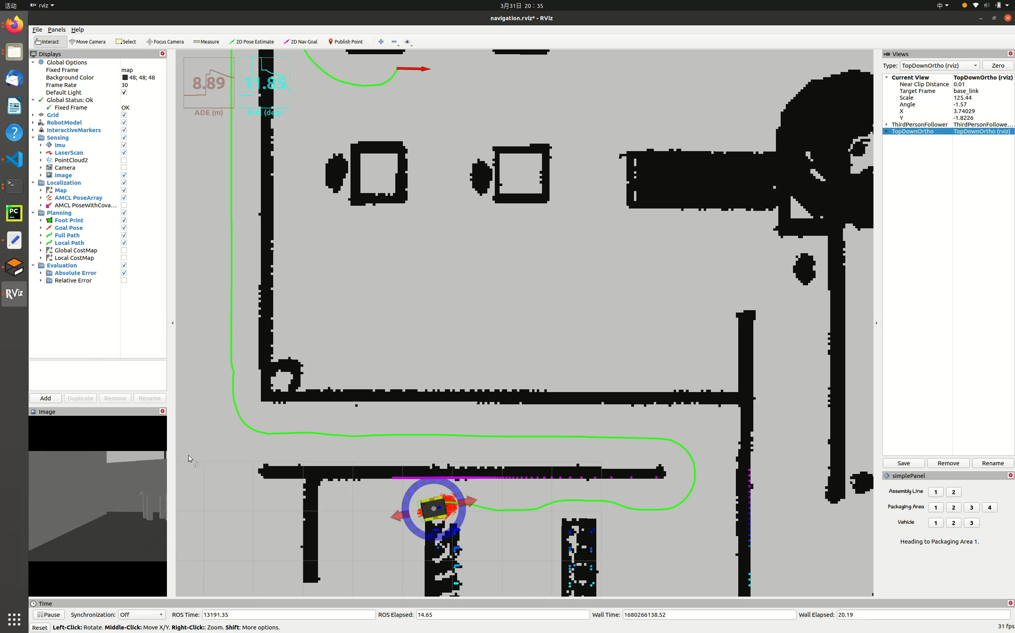
Task 2 Navigation-Planning
Local Planning-TrajectoryPlanner
Gif of corner turning behavior

Slide 25
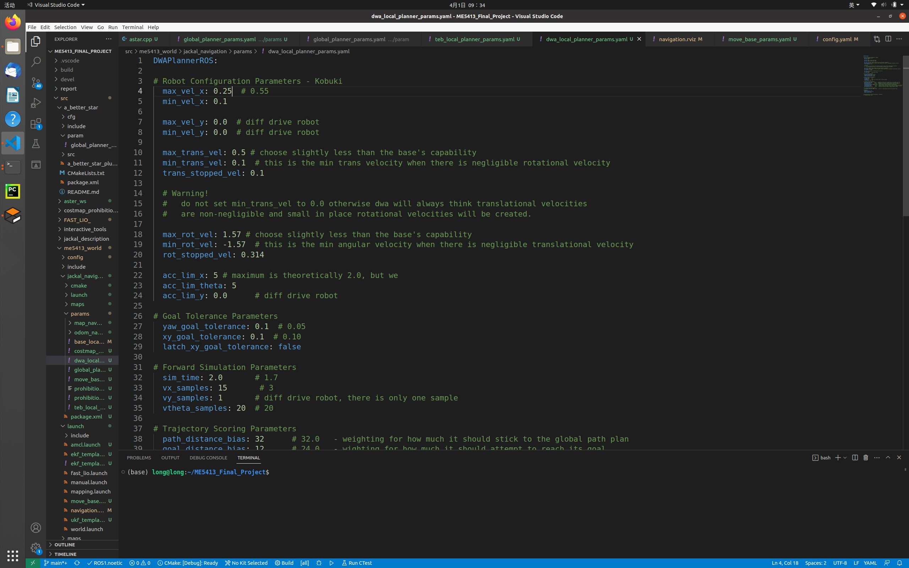
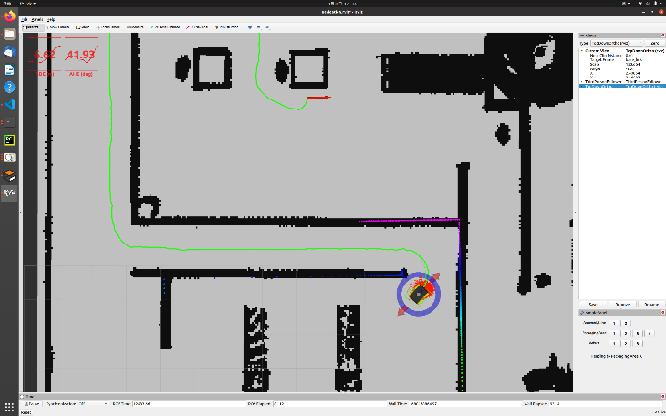
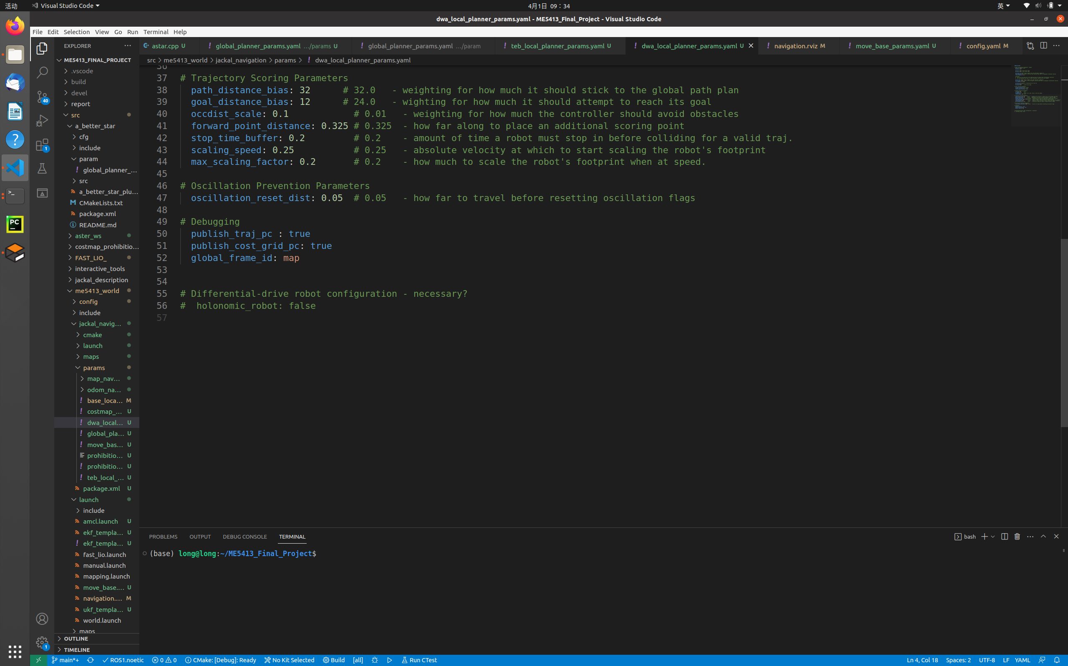
Task 2 Navigation-Planning
Local Planning-DWA
Figure 30. Fine voiding obstacles path by DWA.
Figure 31. dwa_local_planner_params.yaml

Slide 26
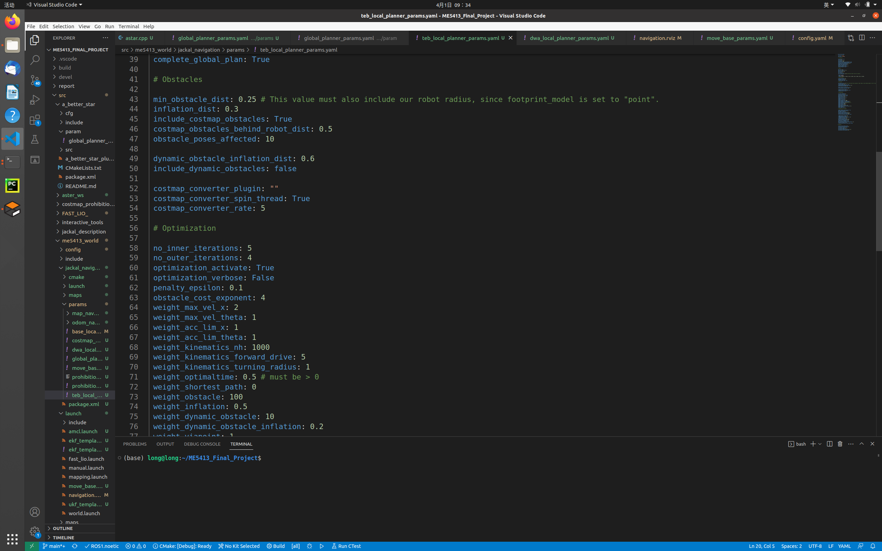
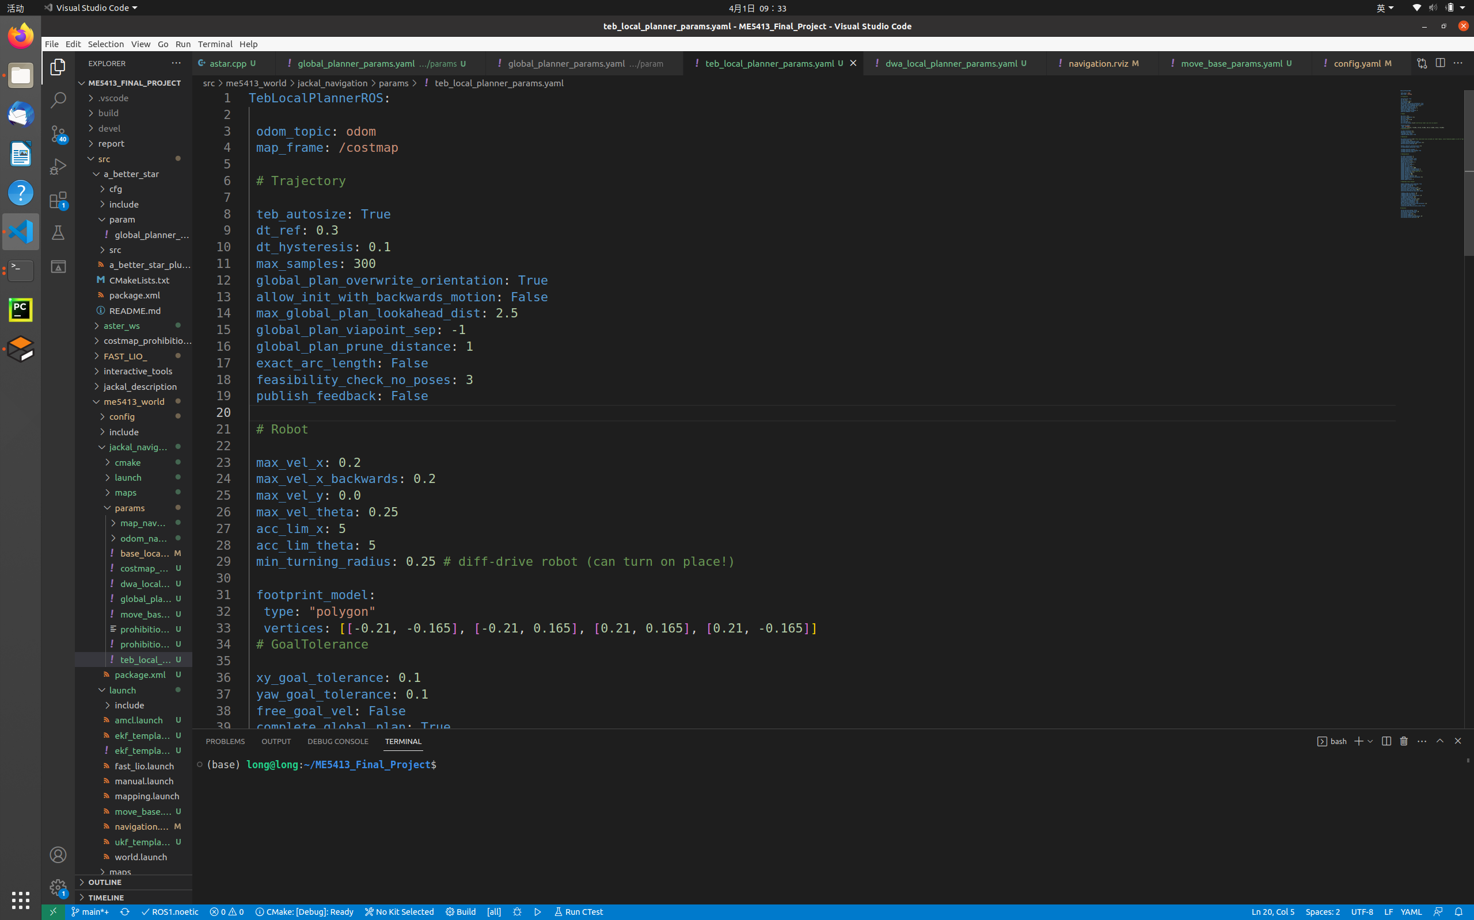
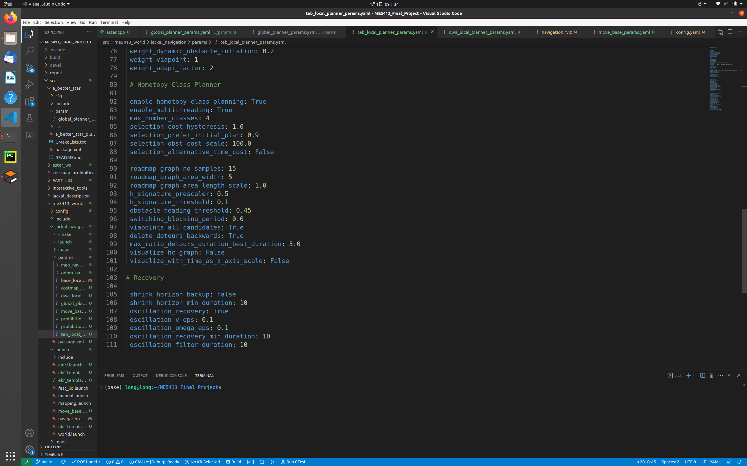
Task 2 Navigation-Planning
Local Planning-TEB
Figure 32. teb_local_planner_params.yaml

Slide 27
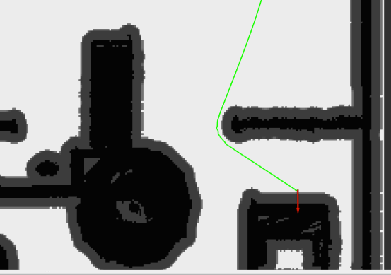
Task 2 Navigation-Planning
Other problems
Problem:
Can not always create the final path to vehicle 1. Sometimes impossible to plan.
Reason: Vehicle 1 inside of the obstacle. (Too close)
Solutions:
Adjust foot padding
Slightly Change the point position (0.1m)
Figure 33. Schematic of vehicle 1 point position

Slide 28
Task 2 Navigation-Planning
Comparison and discussion
 | Global | navfn |  |  | GlobalPlanner |  |  | A_better_star
Local | Error type | Three positions (131) |  |  | Three positions (131) |  |  | Three positions (131)
DWA | Position | 0.18 | 0.06 | 0.08 | 0.24 | 0.08 | 0.19 | 0.16 | 0.21 | 0.02
 | Heading | -6.28 | 3.71 | 4.44 | 4.94 | 0.72 | 2.51 | -4.58 | 1.11 | -4.29
TEB | Position | 0.26 | 0.06 | 0.18 | 0.04 | 0.16 | 0.16 | 0.13 | 0.11 | 0.12
 | Heading | -2.78 | 3.67 | -2.75 | 1.22 | 1.9 | 0.98 | 0.25 | 3.26 | 0.18
Table 1.Errors of different global local planner combination

Slide 29
Reference
1. Xu, W., et al., Fast-lio2: Fast direct lidar-inertial odometry. IEEE Transactions on Robotics, 2022. 38(4): p. 2053-2073.
2. Xu, W. and F. Zhang, Fast-lio: A fast, robust lidar-inertial odometry package by tightly-coupled iterated kalman filter. IEEE Robotics and Automation Letters, 2021. 6(2): p. 3317-3324.
3. Xu, W. and F. Zhang, Fast-lio: A fast, robust lidar-inertial odometry package by tightly-coupled iterated kalman filter. IEEE Robotics and Automation Letters, 2021. 6(2): p. 3317-3324.
4. Derpanis, K.G., Overview of the RANSAC Algorithm. Image Rochester NY, 2010. 4(1): p. 2-3.
5. Stachniss, C., Robotic mapping and exploration. Vol. 55. 2009: Springer.
6. ROSwiki. AMCL. 2021; Available from: http://wiki.ros.org/amcl.
7. Thakur, M.B., M. Schmid, and V.N. Krovi, Benchmarking the Localization Accuracy of 2D SLAM Algorithms on Mobile Robotic Platforms. 2020, SAE Technical Paper.
8. ROSWiki. robot_pose_ekf 2022; Available from: http://wiki.ros.org/robot_pose_ekf.
9. Zheng, K., Ros navigation tuning guide. Robot Operating System (ROS) The Complete Reference (Volume 6), 2021: p. 197-226.
10. ROSWiki. global_planner. 2021; Available from: http://wiki.ros.org/global_planner.
11. CSDN, astar.cpp cpp file, application with ROS' A* algorithm global road strength planner. 2022.
12. WLwind. segment_global_planner. 2021; Available from: https://github.com/WLwind/segment_global_planner.

Slide 30
Reference
13. WLwind, a_better_star. 2019: Github.
14. mech0ctopu, rrt-global-planner. 2022: Github.
15. Tian, Y., et al. An Autonomous Behavior Switching Method for Indoor Mobile Service Robots. in 2021 IEEE International Conference on Mechatronics and Automation (ICMA). 2021. IEEE.
16. Fox, D., W. Burgard, and S. Thrun, The dynamic window approach to collision avoidance. IEEE Robotics & Automation Magazine, 1997. 4(1): p. 23-33.
17. ROSwiki. teb_local_planner. 2021; Available from: http://wiki.ros.org/teb_local_planner.
18. Fankhauser, P., et al. Kinect v2 for mobile robot navigation: Evaluation and modeling. in 2015 international conference on advanced robotics (ICAR). 2015. IEEE.
19. Muñoz, N., J. Valencia, and N. Londono. Evaluation of navigation of an autonomous mobile robot. in Proceedings of the 2007 Workshop on Performance Metrics for Intelligent Systems. 2007.

Slide 31
End
Thanks for watching!

